Slide 1

COLLIGATIVE PROPERTIES
By
Dr T N V S S Satyadev , Assistant Professor,
NAAC Coordinator & IQAC , Co -coordinator,
Department of Chemistry

Slide 2
What is a solution ?
Solution is defined as a homogeneous mixture of two or more substances.
What is a binary solution ?
Solution consisting of only two constituents is known as binary solution.
What is a solute?
The substance which is dissolved is known as solute.
What is a solvent ?
The substance in which solute is dissolved is known as solvent.
(Sugar dissolves in water. Sugar is solute and water is solvent.)

Slide 3
Solutions have different properties than either the solutes or the solvent used to make the solution.
Those properties can be divided into:
Non-colligative properties depend on the identity of the dissolved species and the solvent.
Colligative properties depend only on the number of solute particles present, not on the identity of the solute particles.
Colligative
properties
Non- Colligative
properties

Slide 4
Colligative properties are
Vapour pressure lowering
Boiling point elevation
Depression of freezing point of solvent in solution
Osmotic pressure
Non-colligative properties include
Viscosity
Surface tension
Solubility etc.

Slide 5
Colligative properties are studied mostly for dilute solutions, whose behavior may be approximated as that of an ideal solution.
Explanation
If we compare the properties of:
1.0 M aq. sugar solution and a 0.5 M aq. solution of NaCl.
Despite the conc. of NaCl = ½ the conc. of sucrose both solutions have precisely the same number of dissolved particles, why?
NaCl dissociates into two particles upon dissolution a Na⁺ and a Cl⁻.
Both solutions have the same
freezing point, boiling point, vapor pressure, and osmotic pressure because those colligative properties of a solution only depend on the number of dissolved particles.

Slide 6
At higher concentrations of solute
The freezing point depression,
Boiling point elevation,
Vapour pressure lowering, and
Osmotic pressure are all dependent on the chemical nature of the solvent and the solute.
MOLE FRACTION & MOLALITY
MOLE FRACTION OF Component i ( X_{i} )= n _{i} / n _{total}
MOLALITY = Moles of Solute / kg Solvent
Note: In dilute solutions, Molality & Molarity have nearly the same values! Molality is independent of Temperature.

Slide 7
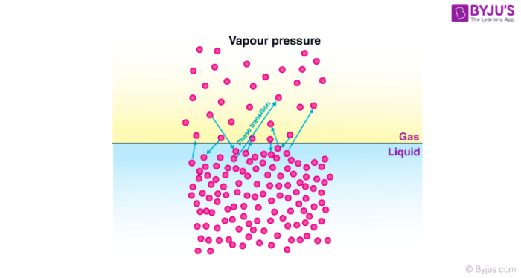
Relative Lowering of Vapour Pressure
Vapour pressure is the pressure exerted by the vapours over the liquid under the equilibrium conditions at a given temperature.

Slide 8
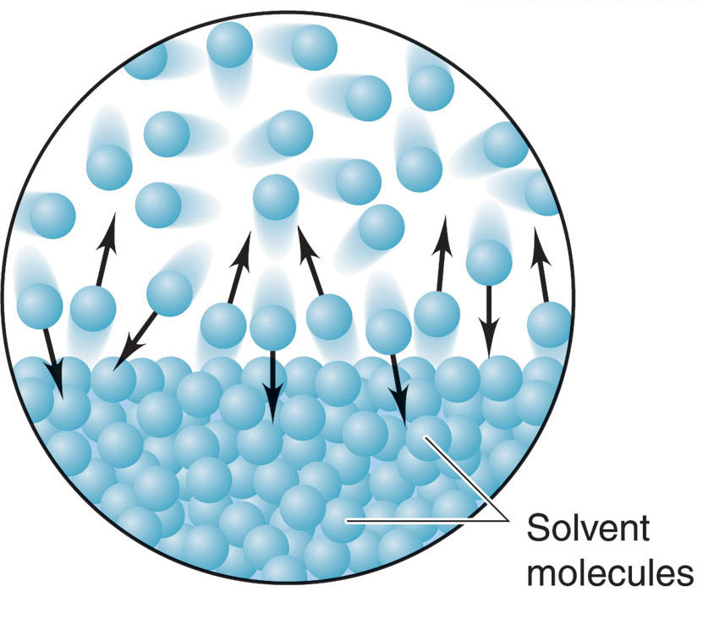
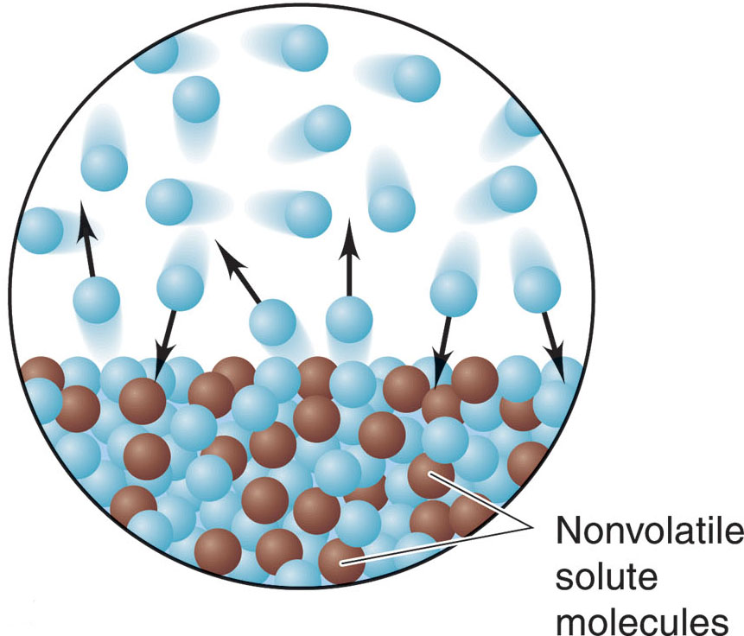
Vapour pressure of a solvent is lowered when a non-volatile solute is dissolved in it to form a solution.
In a pure liquid, the surface of the liquid is occupied by the molecules of the liquid
Addition of non-volatile solute to this pure liquid. The vapour pressure of the solution is found to be lower than that of the pure liquid at a given temperature.

Slide 9
This lowering in vapour pressure is due to the fact
Liquid surface now had molecules of both, the pure liquid and the solute.
Number of solvent molecules escaping into vapour phase gets reduced
As a result the pressure exerted by the vapour phase is also reduced.
This is known as relative lowering of vapour pressure.
Mathematical Representation
Let us assume a binary solution in which the mole fraction of the solvent be x₁ and that of the solute be x₂, p₁ be the vapour pressure of the solvent and p₁º be the vapour pressure of the solvent in pure state.
According to Raoult’s Law:
p₁=x₁p₁º…………………………..(1)

Slide 10
The decrease in vapour pressure of the solvent (∆p₁) is given by:
=> ∆p₁=p₁º-p₁
=> ∆p₁=p₁º-p₁ºx₁ [using equation (1)]
=> ∆p₁=p₁º (1-x₁)
Since we have assumed the solution to be binary solution, x₂=1-x₁
=> ∆p₁=p₁ºx₂
=> x₂= ∆p₁/p₁º or p₁º-p₁/ p₁º
The above equation gives the relative lowering in vapour pressure which is equal to the mole fraction of the solute.

Slide 11
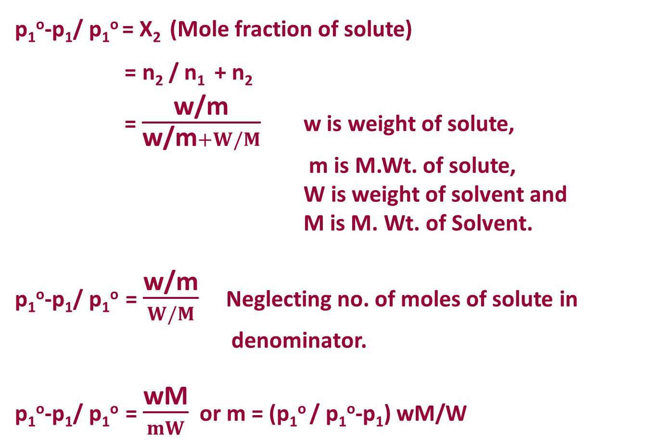
p₁º-p₁/ p₁º = X₂ (Mole fraction of solute)
= n₂ / n₁ + n₂
= $\frac{\text{w}\text{/}\text{m}}{\text{w}\text{/}\text{m}+W/M}$ w is weight of solute,
m is M.Wt. of solute,
W is weight of solvent and
M is M. Wt. of Solvent.
p₁º-p₁/ p₁º = $\frac{\text{w}\text{/}\text{m}}{W/M}$ Neglecting no. of moles of solute in denominator.
p₁º-p₁/ p₁º = $\frac{\text{w}\text{M}}{mW}$ or m = (p₁º / p₁º-p₁) wM/W

Slide 12
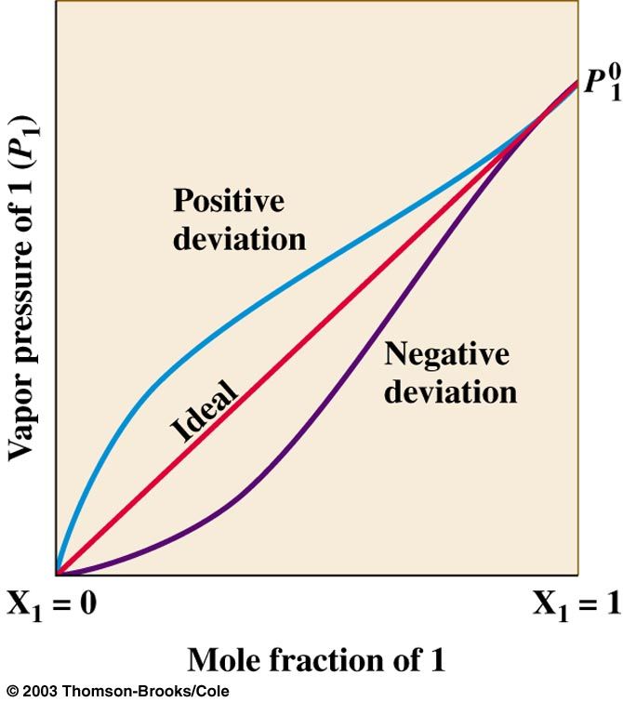
Ideal Solutions and Deviations from Raoult's law
Solutions that obey Raoult's law are called ideal solutions.
Solutions that show a deviation from Raoult's law are called non-ideal solutions.
If Solute - Solvent Interactions > Solvent – Solvent Interactions, then negative deviations are possible.
If Solute - Solvent Interactions < Solvent – Solvent Interactions, then positive deviations are possible.

Slide 13
BOILING POINT ELEVATION
BOILING POINT
Boiling point is defined as the temperature at which the vapour pressure of liquid becomes equal to the atmospheric pressure.
Boiling point is a characteristic property of liquids and is criterion to check the purity of liquids.
Liquids having grater intermolecular forces have high boiling point.

Slide 14
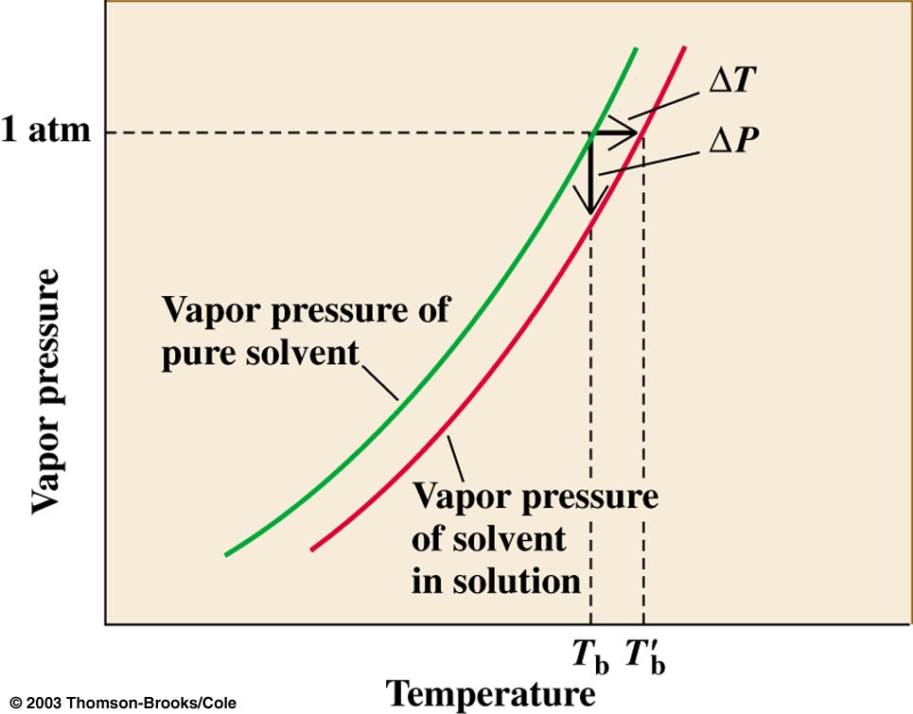
ELEVATION OF BOILING POINT
It is known that a liquid boils only when its vapour pressure becomes equal to the atmospheric pressure. But when a nonvolatile solute is added to the solvent, the vapour pressure is lowered.
In order to boil the solution, the temperature has to be raised further so as to make its vapour pressure equal to atmospheric pressure.
T_{b}^{I} = T_{b} + ∆T_{b}
∆T_{b} = T_{b}^{I} - T_{b}

Slide 15
ΔT_{b} is known as the elevation in boiling point.
ΔT_{b} for a solution depends upon the number of molecules of the non-volatile solute.
The elevation in boiling point is directly proportional to the molal concentration of the solute in a solution.
ΔT_{b} = i K_{b} m
m : molality (because molality is temperature independent).
K_{b} : boiling point elevation constant that depends on the particular solvent being used. (K_{b} water = 0.51)
i: van't Hoff factor and represents the number of dissociated moles of particles per mole of solute

Slide 16
Depression of Freezing Point
Normal freezing or melting point: is the temp. at which solid & liquid are in equilibrium under 1 atm.
Addition of solute will decrease the vapor pressure and so will decrease the freezing point
In order for a liquid to freeze it must achieve a very ordered state that results in the formation of a crystal.
If there are impurities in the liquid, i.e. solutes, the liquid is inherently less ordered. Therefore, a solution is more difficult to freeze than the pure solvent so a lower temperature is required to freeze the liquid.

Slide 17
In analogy to the boiling point elevation, we can calculate the amount of the freezing point depression using the following formula:
ΔT_{f}= - i K_{f} m (ΔT_{f}=T_{f}°(solvent)−T_{f}(solution) )
the –ve sign because the freezing point of the solution is less than that of the pure solvent.
m: molality (because molality is temperature independent).
K_{f}: molal depression constant that depends on the
particular solvent being used. (K_{f} water = 1.86)
i: van't Hoff factor and represents the number of dissociated
moles of particles per mole of solute
Note: freezing point depression and boiling point elevation are a direct result of the lowering of vapor pressure

Slide 18
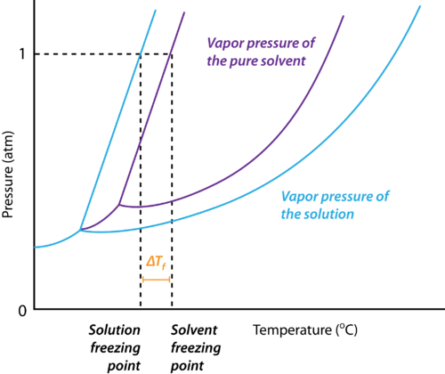

Slide 19
ABNORMAL BEHAVIOUR OF SOLUTIONS
Colligative properties of solution depends on number of solute particles present in the solution.
One mole of a solute like glucose, urea etc., when dissolved in 1000kg of water – depresses the freezing point by 1.86⁰ .
However one mole of NaCl in 1000 kg of water depresses the freezing point by 3.72⁰ ( 2 X 1.86⁰) and one mole of BaCl₂ depresses the freezing point by 5.58⁰ (3 X 1.86⁰ ). Why ?
One mole NaCl → one mole of Na⁺+ one mole of Cl⁻ (2 moles of ions) and
One mole BaCl₂ → one mole of Ba⁺² + 2 moles of Cl⁻ (3 moles of ions)
From the expressions derived for colligative properties it is evident that colligative property is inversely proportional to Molecular weight.

Slide 20
Molecular Weight α 1/ Colligative property
For substances which dissociates in solution (electrolytes) the observed molecular weight will be less than the real molecular weight.
Substances which undergo association in solution the observed molecular weight will be more than the real molecular weight.
Example : Acetic acid in Benzene exists as a dimer (CH₃COOH)₂ .
The molecular weight of a substance determined from colligative property may be more or less than the theoretically calculated.
To account for such anomalies Van’t Hoff introduced a factor ‘i‘

Slide 21
Van’t Hoff’s Factor
The van 't Hoff factor i (named after Dutch chemist Jacobus Henricus van 't Hoff) is a measure of the effect of a solute upon colligative properties.
It is defined as the ratio of observed colligative property produced by a given concentration of electrolytes solution to the property observed for the same concentration of non electrolyte solutions.
    i = No. of particles in solution per formula unit (range 1 – n)
    i.e. for sucrose i = 1 [no dissociation]
    for NaCl i = 2 [NaCl → Na⁺+Cl⁻]
    for K₂SO₄ i = 3 [K₂SO₄ → 2K⁺ + SO₄²⁻ ]

Slide 22
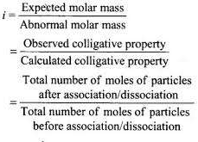
The Van’t Hoff Factor is denoted by letter ‘i’. Van’t Hoff defined this factor as follows:

Slide 23
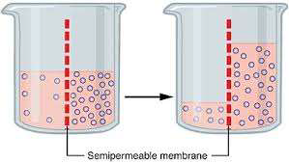
OSMOSIS
Osmosis is the movement of water or other solvent through a plasma membrane from a region of low solute concentration to a region of high solute concentration. So the differences in concentration disappear.
Osmosis is passive transport, meaning it does not require energy to be applied

Slide 24
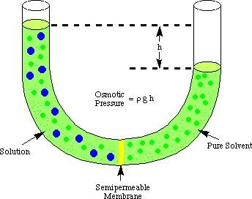
The diffusion of solvent through semipermeable membrane is called osmosis .
OSMOTIC PRESSURE
This is the external pressure that must be applied to the solution in order to prevent it being diluted by the entry of solvent via osmosis.

Slide 25
π = ρ g h
where
• ρ is the density of the solution,
• g = 9.80665 m/s² is the acceleration due to gravity, and
• h is the difference in height of the pure solvent and the solution with added solute.
Van’t Hoff’s Law of Osmotic Pressure
Quantitative relationship between the concentration of the solution and the osmotic pressure was first derived by Van’t Hoff in 1886.
These are known as Van’t Hoff laws of Osmotic Pressure.
First Law ( Van’t Hoff – Boyle’s Law)
The osmotic pressure of a solution is directly proportional to it’s Concentration.
π α C at constant T …… (1)

Slide 26
If V is volume containing one mole of solute , then C= 1/V
Thus π α 1/V at constant T
Therefore π V is constant
Second Law (Van’t Hoff – Charles Law)
The osmotic pressure of a solution of given concentration is directly proportional to absolute temperature
π α T if temperature is constant …….. (2)
Third Law (Van’t Hoff – Avogadro’s Law)
Equimolecular quantities of different solutes dissolved in such volumes of solvent of the solution have the same osmotic pressure at the same temperature.
Combining (1) and (2)

Slide 27
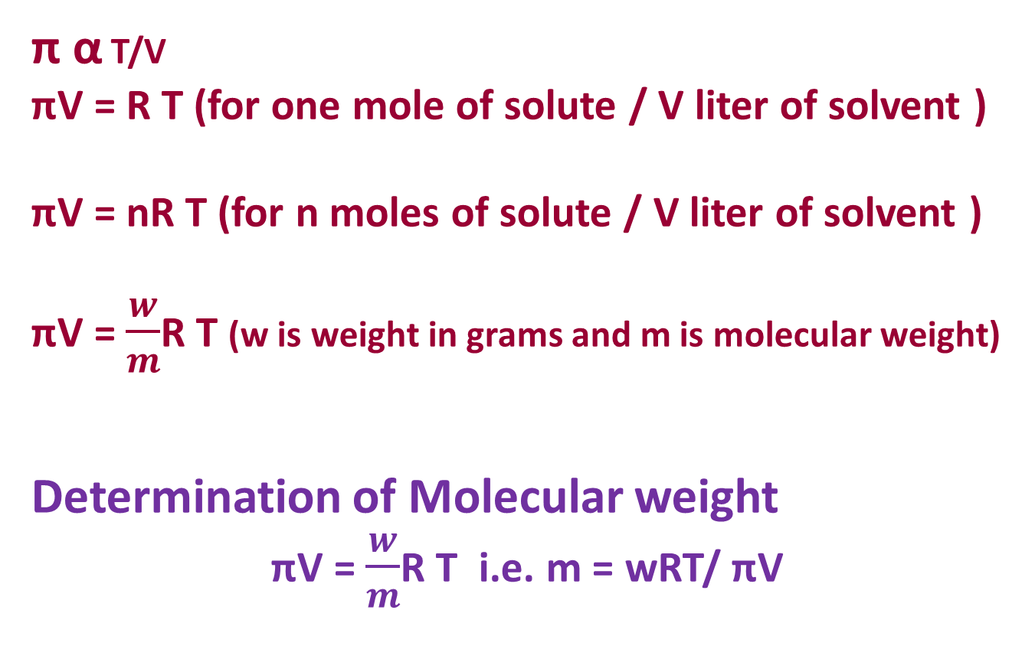
π α T/V
πV = R T (for one mole of solute / V liter of solvent )
πV = nR T (for n moles of solute / V liter of solvent )
πV = $\frac{w}{m}$R T (w is weight in grams and m is molecular weight)
Determination of Molecular weight
πV = $\frac{w}{m}$R T i.e. m = wRT/ πV

Slide 28
π V = nRT
π= n/V RT
π = c R T
π = m R T
π = Osmotic pressure
T = absolute temperature
n = number of moles
V = volume in liter
c = molarity (n/V)
m = molality (n/wt)
π = c R T -----Van’t Hoff’s Equation
π = m R T ------- Morse Equation

Slide 29
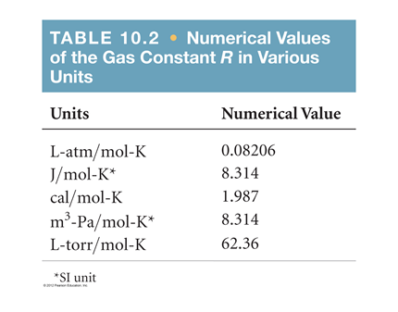
Numerical Values of constant R or S in different units

Slide 30


Slide 31
DISCONNECTION APPROACH
(Retrosynthetic Analysis)
Dr T N V S S Satyadev
Department of Chemistry,
P B Siddhartha College of Arts & Science

Slide 32
Introduction
Organic compounds are diverse in nature and have wide range of applications (Figure 1). They have been found useful in all walks of life including food, pharmaceuticals, cosmetics, polymers, detergents etc. One of the major tasks that the organic chemists face is their synthesis. Disconnection approach is a reliable means for the design of their synthesis. This is also known as the retrosynthetic analysis. This is the reverse method of observing a molecule keeping their synthesis in mind. This is a synthetic route to the target molecule from the simpler molecule or simpler starting materials. This approach of “disconnection” to synthesis is now a basic part of every organic synthesis course.
Professor Elias J. Corey of Harvard University won the noble prize for introducing the concept of retrosynthetic analysis in 1990. According to him “Retrosynthetic (or antithetic) analysis is a problem solving technique to convert the structure of a synthetic target (TGT) molecule to a series of gradually simpler structures via a path which finally indicates to simple or commercially available starting materials for a chemical synthesis”.

Slide 33
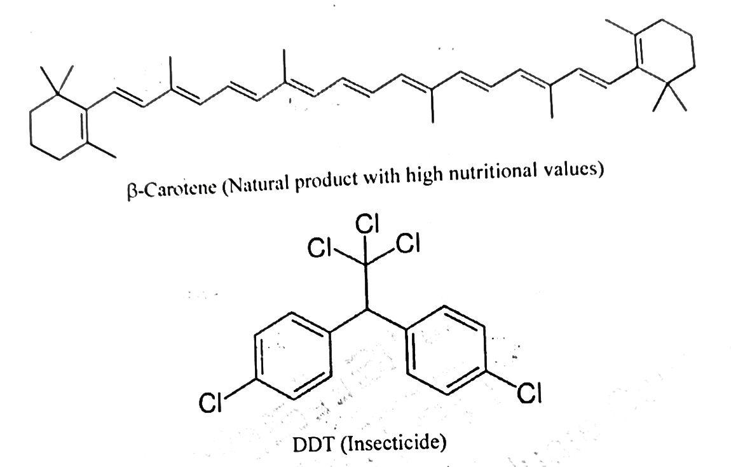
The main goal of a retrosynthetic analysis is to reduce the molecule to similarly sized building blocks of lower or similar complexity. This process of simplification should be continued until one reach molecules which are commercially available.

Slide 34
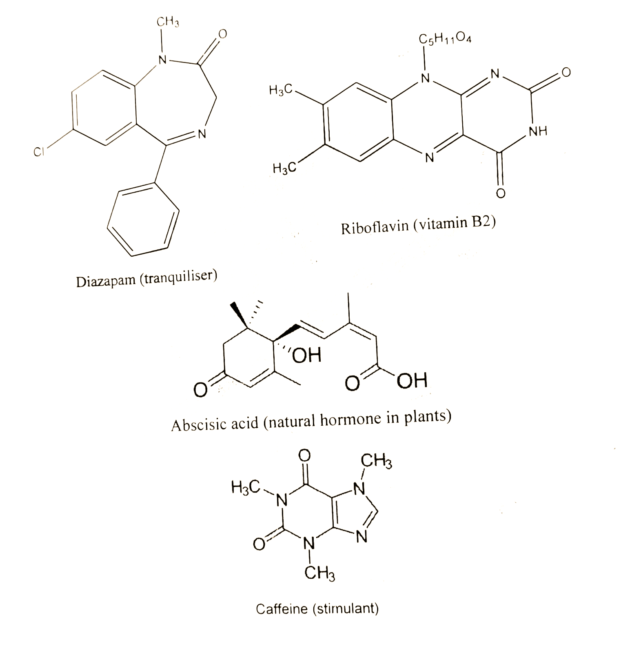
Figure 1: Examples of important molecules

Slide 35
The chemical structure and their applications of very few molecules are given in the figure 1. The design of their synthesis requires the help of disconnection approach. For synthesizing a target molecule (TM, the molecule to be synthesized), a synthetic route must be designed to give a pure sample of the TM using a convenient and efficient procedure. A given synthetic route is a sequence of reactions designed to convert commercially available starting materials into the desired product.
Disconnection Approach or Retrosynthetic Analysis
A logical approach for designing organic syntheses which involves breaking down of the target molecule into available starting materials by imaginary breaking of bonds (disconnection) and/or by Functional Group Interconversion (FGI) is known as disconnection approach or retrosynthetic analysis or retrosynthesis or synthesis backwards. This is the process of synthesis design which starts with the product and works backwards towards the starting material.
A double line arrow (=>) called a retrosynthetic arrow is commonly used to indicate a reaction written backwards; the actual reaction is in reverse. The following scheme with a retrosynthetic arrow means Z could be prepared from X and Y.

Slide 36
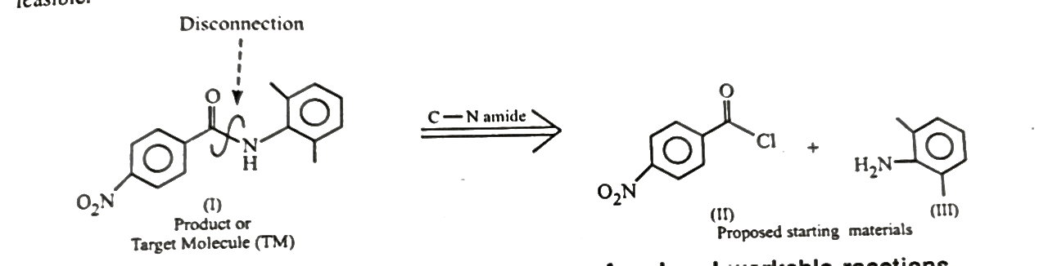
a retrosynthetic arrow
Z ==================> X + Y
The following ester can be prepared from benzyl alcohol and benzoyl chloride. Thus it is possible to represent the reaction using a retrosynthetic arrow as shown below.
The following amide (I) can be prepared from p-nitrobenzoyl chloride (II) and 2,6- dimethylaniline (III). The entire sequence can be represented using a retrosynthetic arrow. Imaginary breaking of a molecule into its component parts like this is known as disconnection, and it is helpful to indicate the site of the disconnection with a wiggly line.

Slide 37
In the above case of amide (I) formation, it was chosen to disconnect the C-N bond because this disconnection corresponds to the reverse of a real and workable reaction, i.e., formation of the amide (I) from the amine (III) and acyl chloride (II). This is the best disconnection of (I) because no other possible disconnection of this molecule corresponds to the reverse of such a real and workable reaction which yields (I). Disconnections are the reverse of synthetic steps or reactions and for every disconnection there must be a real and workable reaction in mind for effecting the corresponding reconnection (bond formation).
The design of a synthetic pathway for any molecule needs to take into account some of the important aspects like:
The methodology actually works in the experimental condition.
In general, the number of synthetic steps must be as less as possible.
The yield of each step must be good to excellent.
The side products and impurities must be easily separable from the desired product.
The synthetic steps must follow principle of green chemistry.
The synthetic process must be economically viable.
When one applies disconnection approach or retrosynthetic analysis for a target molecule, one must take into account of the above mentioned aspects.

Slide 38
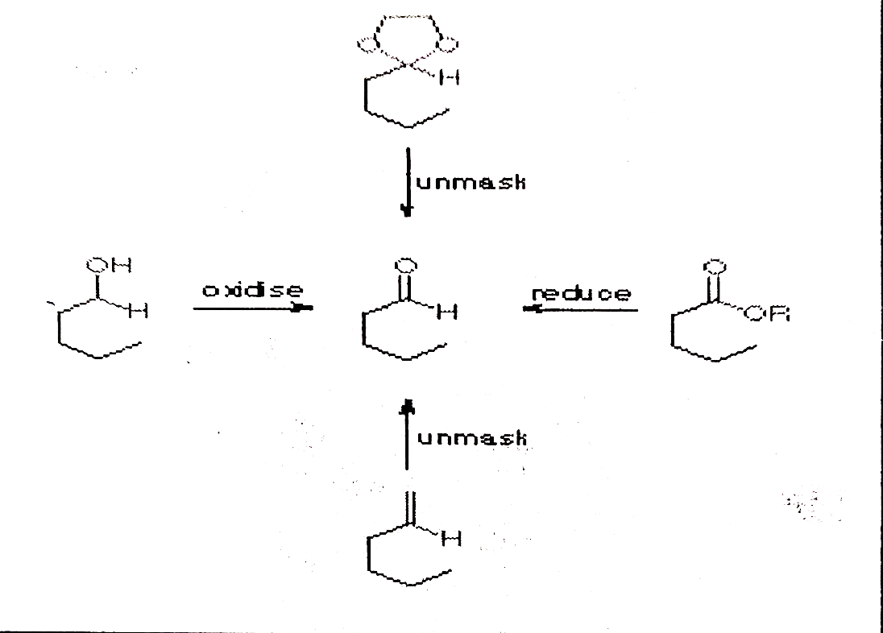
Transformations in Retrosynthesis
The following ways of transformation are useful in retrosynthetic analysis:
Functional Group Interconversion (FGI)
Many functional groups can be interconverted into each other, e.g., oxidation of an alcohol gives an aldehyde, and further oxidation gives carboxylic acid. Many organic transformations can be used to do FGIs. Carbonyl groups are particularly useful in this respect. The reactivity of the carbonyl group can be masked during synthesis as double bond (ozonolysis for FGI into aldehyde) or dioxolane until needed.

Slide 39
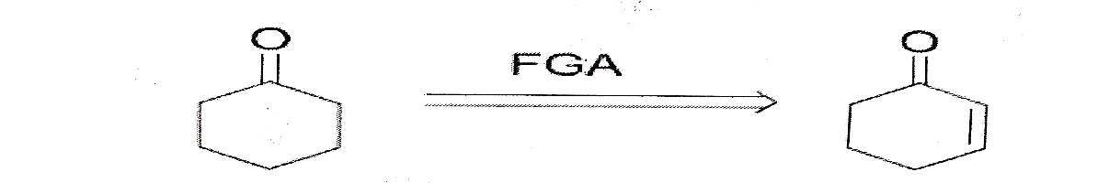
Functional Group Addition (FGA)
Retrosynthesis gives a “more” functionalized compound. The basis of using FGA could be that the specific function is easier to make or that the specific function enables installation of other functional groups. As one can see here that the cyclohexanone is converted into cyclohex-2-enone using FGA. Here, one can see that the single functional group in cyclohexanone, ie. carbonyl group gets converted by FGA to two functional groups, in cyclohex-2-enone ie. alkene and carbonyl group. There is an additional of one functional group. In the other example of FGA, the hydroxyl functional group has been added to the existing chloro functional group.

Slide 40
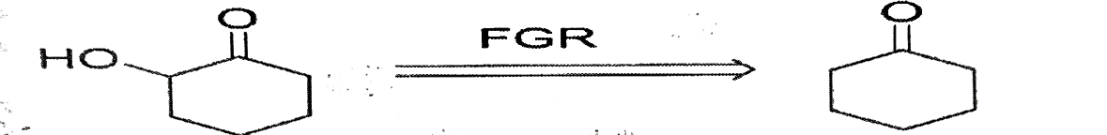
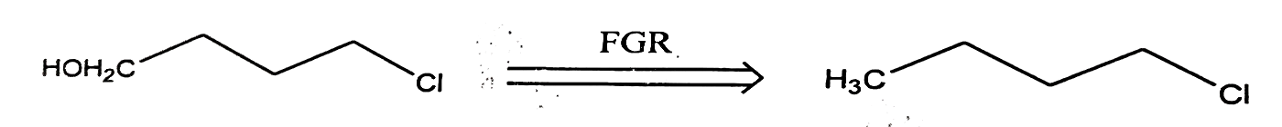
Functional Group Removal: FGR
This transformation involves the removal of a particular functional group during the retrosynthesis. As is seen in the figure 5 below, the alcoholic functional group is removed from the hydroxyl cyclohexanone to give us cyclohexanone. The other example shows the removal of functional group, hydroxyl group.

Slide 41
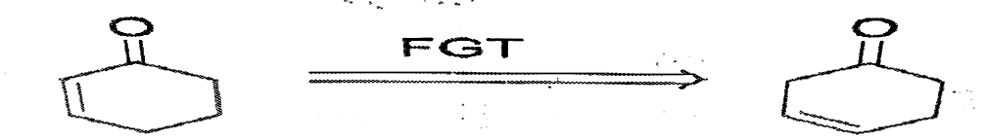
Functional Group Transposition (FGT)
This particular transformation involves the interchange of a functional group during retrosynthesis. Isomerisation can be another term for the description of FGT.
Important terms in Retrosynthesis (Definition of some terms)
Term | Definition
Target Molecule (TM): | The molecule to be synthesized.
Disconnection | An imaginary bond breaking corresponding to the reverse of a real reaction.
Functional Group Interconversion (FGI) | The process of interconverting one functional group into another during retrosynthetic analysis.
Retrosynthetic analysis or retrosynthesis or disconnection approach or synthesis backwards | The process of breaking down a target molecule (TM) into available starting materials by disconnections and/or functional group interconversions (FGI)
Retrosynthetic arrow | A double line arrow,=>, used to indicate the reverse of a synthetic reaction
Synthon | An idealized fragment (usually a cation or anion) resulting from a disconnection
Synthetic equivalent | A real chemical compound (reagent) carrying out the function of a synthon

Slide 42
Synthons and Synthetic Equivalents:
Synthons are the chemical fragments obtained from the disconnection of bond(s) of the target molecule. The disconnection of bond(s) is possible in three ways:
Homolytic cleavage
Heterolytic cleavage
Concerted transform
The homolytic cleavage is a process of bond dissociation where each fragments present in the parent compound retains one of the originally bonded electrons (Figure 1). This leads to the formation of free radical species.
The heterolytic cleavage is a process of bond dissociation where both the electrons forming the bond shifted to one fragments present in the parent compound (Figure 1). This process leads to the formation of ions. One part possessing the electrons is called cation whereas other part is called anion.
The concerted transform leads to the formation of neutral species

Slide 43
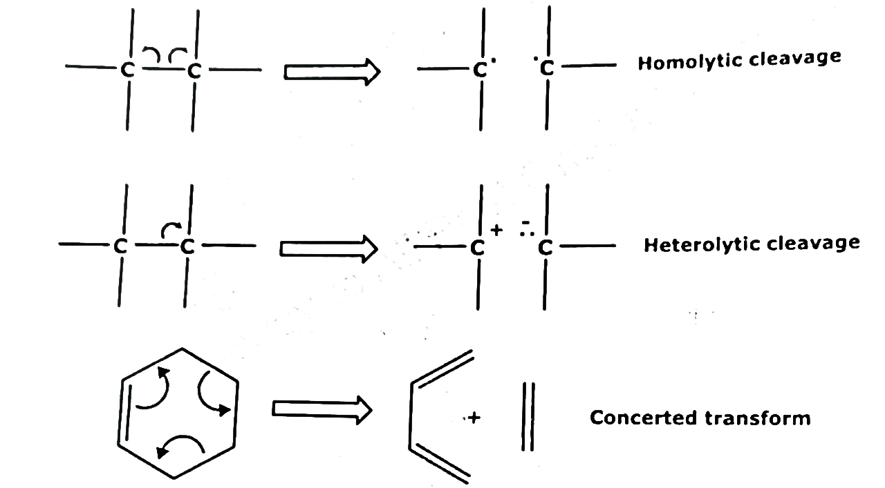
Heterolytic cleavage for disconnection of a carbon-carbon bond in a molecule breaks the target molecule an acceptor synthon (a carbocation) and a donor synthon, (a carbanion).
The formation of any C-C bond involves the union of an electrophilic acceptor synthon and a nucleophilic donor synthon.

Slide 44
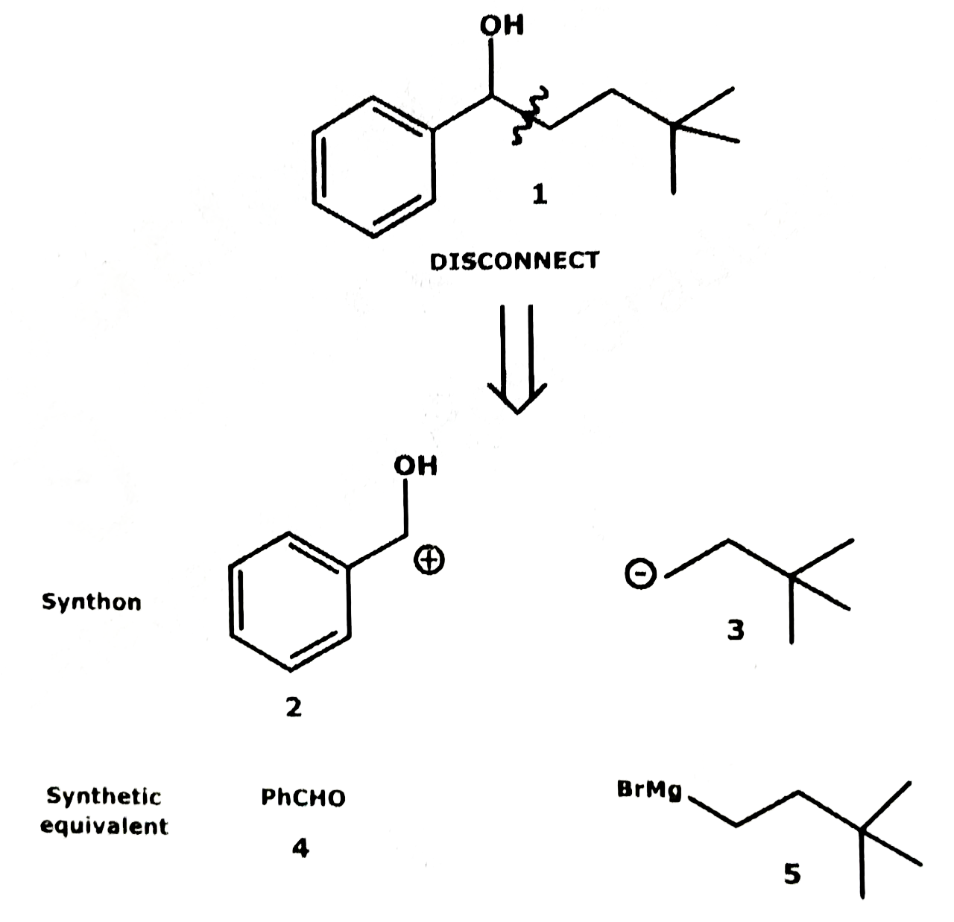
Synthetic equivalents are the chemical species which are used to generate synthons. They are the actual substrates used for the forward reaction and hence forward synthesis. Also, the synthetic equivalents are the reagents derived from inverting the polarity of synthons. For example, in the retrosynthesis of 4,4-dimethyl-1-phenylpentan-1-ol (1), the synthons and corresponding synthetic equivalents are given below.
The cleavage of the compound (1) between C-2 and C-3 gave the synthons (2) and (3) that can be generated from the synthetic equivalents (4) and (5) respectively.

Slide 45
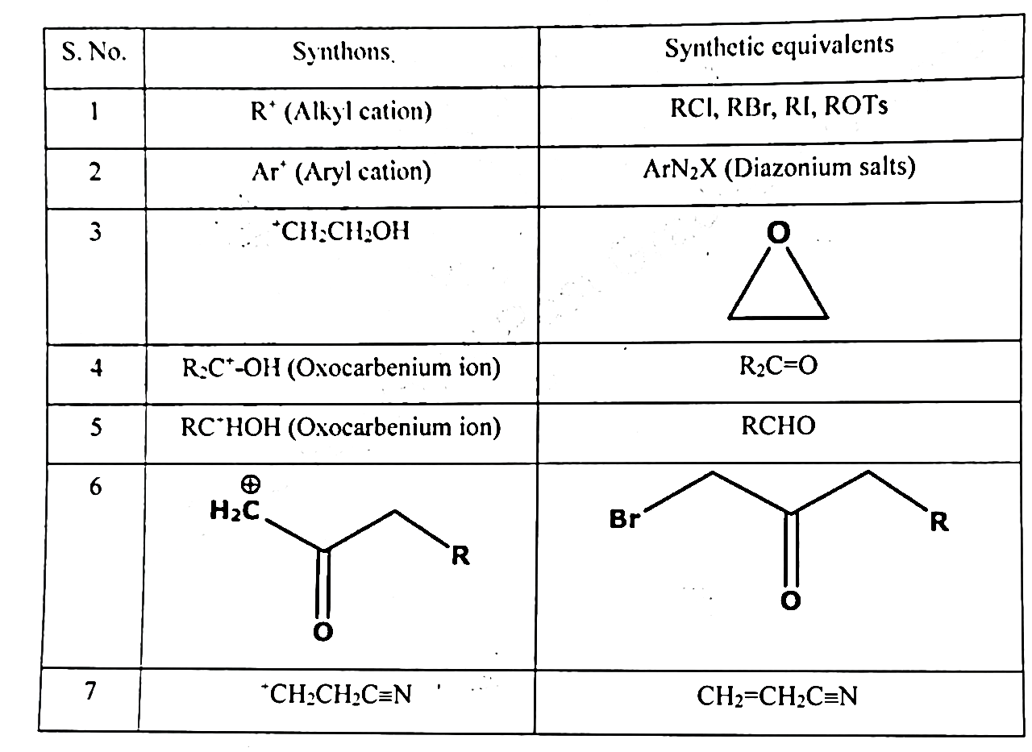
The list of electrophilic acceptor synthons and nucleophilic donor synthons along with their corresponding synthetic equivalents are listed in Table 1 and 2.
Table 1. List of common acceptor synthons and their synthetic equivalents

Slide 46
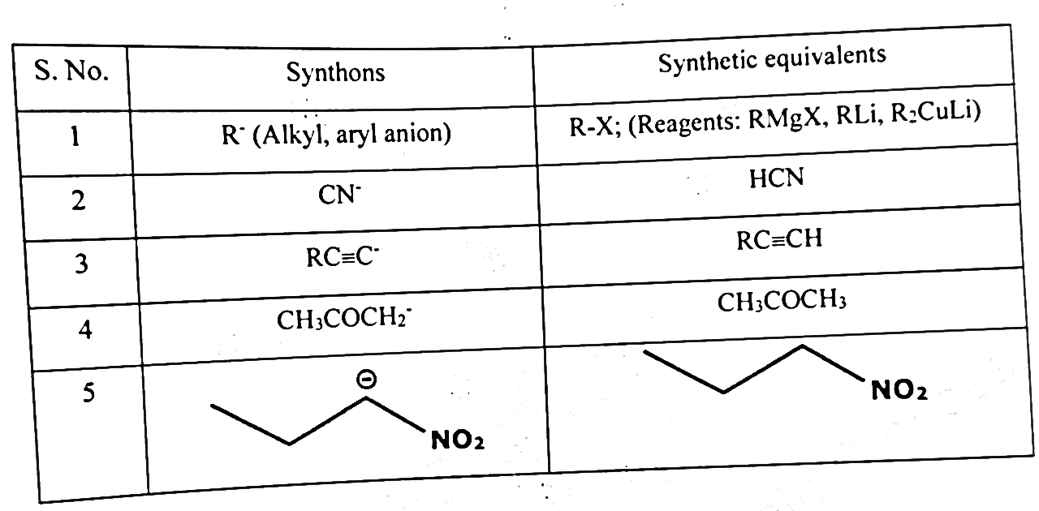
Table 2. List of common donor synthons and their synthetic equivalents

Slide 47
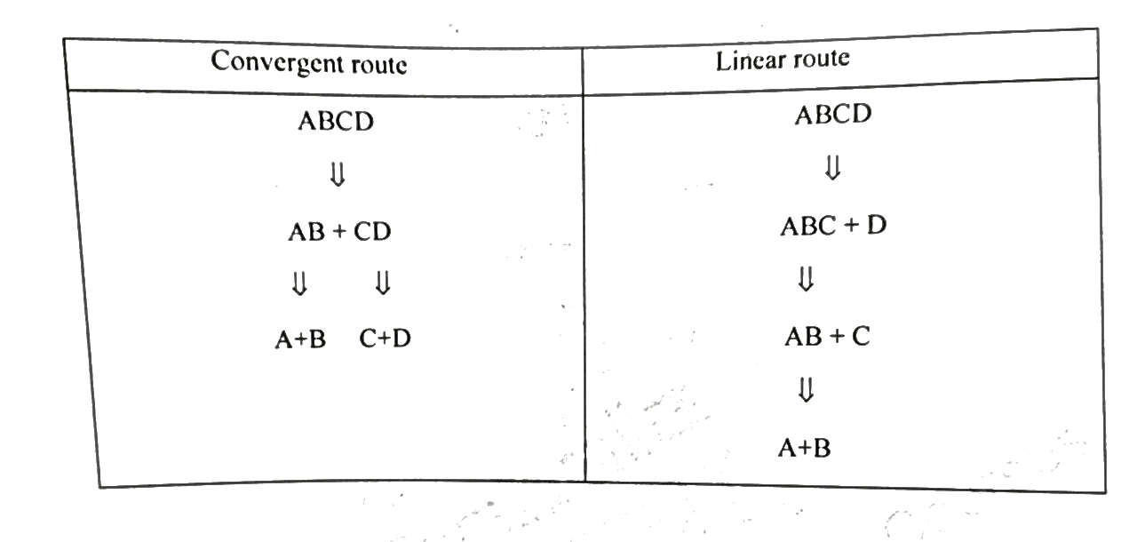
Strategy in retrosynthesis: For making the strategy in retrosynthesis, different possibilities have to be worked out. One can try a number of disconnections and functional group interconversions based on the basic knowledge of basic organic chemistry.
There are two types of routes possible,
(i) Convergent route
(ii) Linear route
A comparative pathway for both the routes are summarized here under. Let us consider a compound ABCD and understand the possible disconnection approaches for this molecule.
Convergent Route | Linear Route

Slide 48
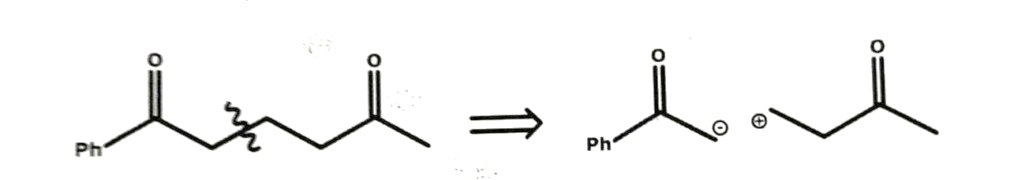
The convergent route has been found to be better than the linear one with respect to the overall yield.
Hence, for the disconnection of any molecule, we must keep in mind the following rules for simplification:
Target middle of the molecule
Disconnect at branch points
Look for the bond which makes the symmetry of the molecule.
For example: The cleavage in the middle of the molecule

Slide 49
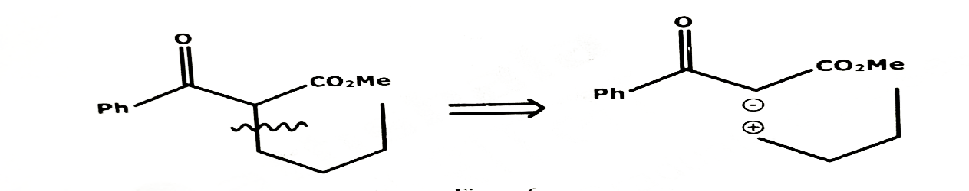
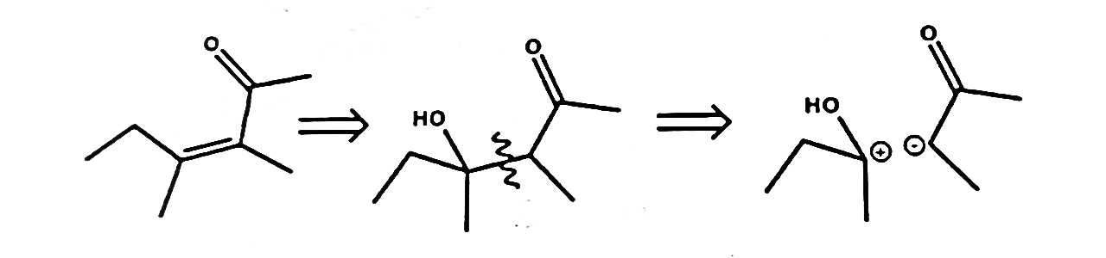
Disconnection at the branch point
Disconnection at the symmetry point
Guideline 1: Disconnection must correspond to the reverse of real and workable reactions.
The analysis of the ortis odour ketone (3) could be tackled by two possible approaches. One (b) gives starting materials which would react in the right orientation since the ketone group in (a) is meta directing. The order of events in the synthesis follows.

Slide 50
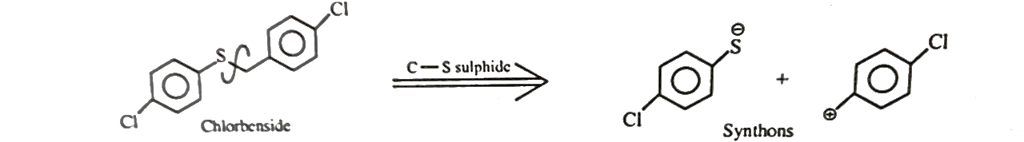
Synthesis
Guideline 2: For compounds consisting of two parts joined by a heteroatom, disconnect next to the heteroatom.
This guideline works for esters, amides, ethers, amines, acetals, ketals, sulphides, and so on, because these compounds are often prepared by a substitution reaction.
Chlorbenside is used as acaricide to kill ticks and mites. Using guideline 2 it is possible to suggest disconnection next to the Sulphur atom, and using guideline 1 one has to disconnect on the alkyl side and not on the aryl side.
Analysis

Slide 51
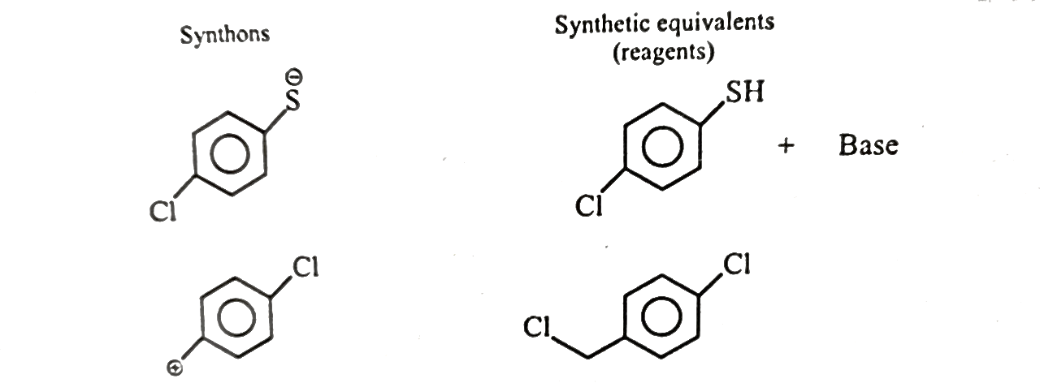
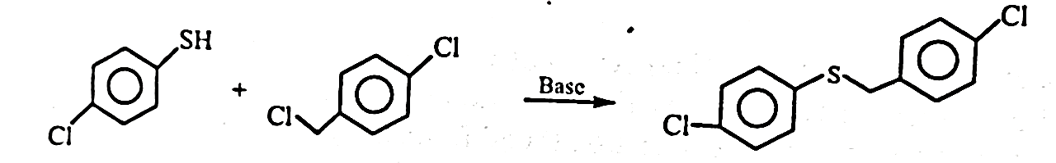
Synthetic equivalents corresponding to the above synthons can be suggested as follows.
Synthesis of chlorbenside

Slide 52
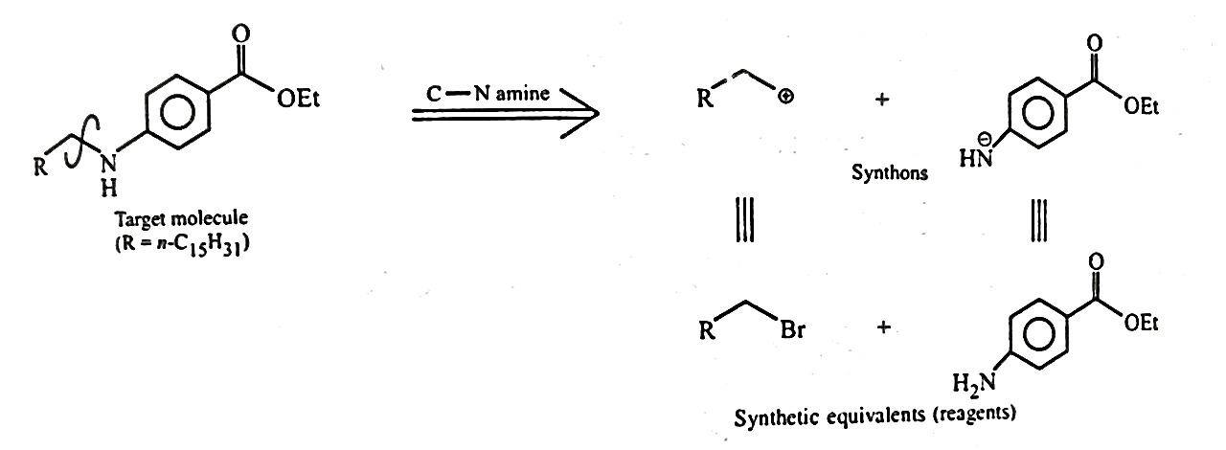
Example 2: Cataben ethyl ester
Cataben ethyl ester is precursor to a drug used for lowering blood lipid level. It is an amine and hence disconnection can be applied next to the nitrogen atom.
Analysis

Slide 53
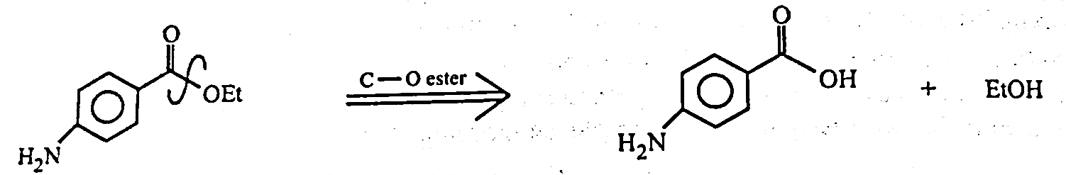
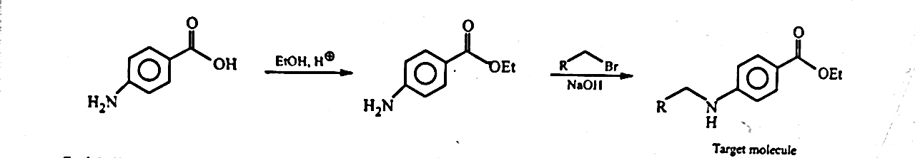
Analysis
Synthesis

Slide 54
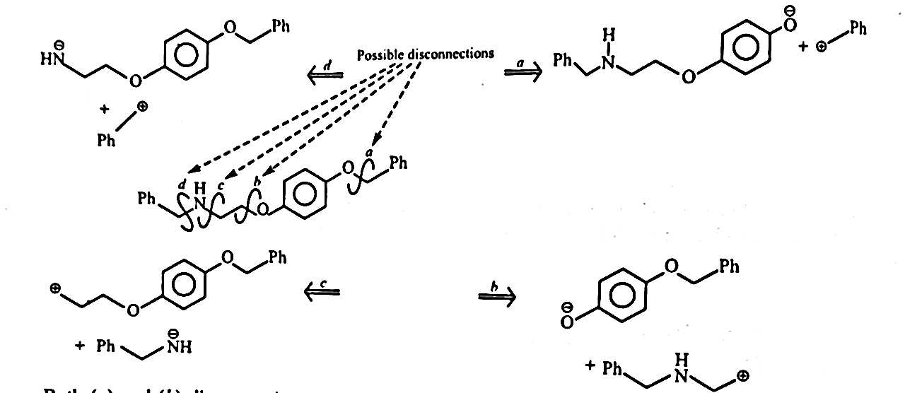
Guideline 3: Consider alternate disconnections and choose routes that avoid chemo-selectivity problems. This can often be done by disconnecting more reactive groups first.
The following compound is an intermediate in the synthesis of the potential anti-obesity drug ICI-D7114. With an amine and two ether groups it requires several disconnections to take it back to available starting materials.
Analysis

Slide 55
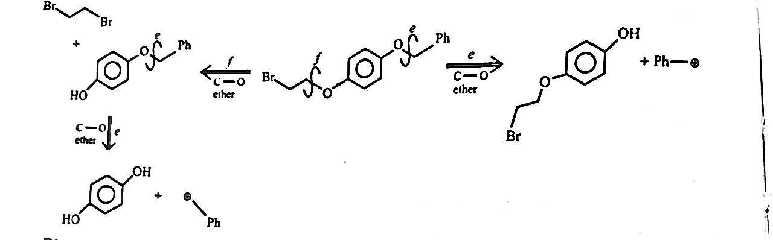
Both (a) and (b) disconnections pose problems of chemo-selectivity as it would be hard to alkylate phenol selectively in the presence of the basic nitrogen atom . Between (c) and (d), (c) appears to be the better choice. Because the next disconnection after (d) will have to be an alkylation of O in the presence of an NH₂ group. To avoid chemo-selectivity problems like this more reactive groups should be introduced late in the synthesis, i.e., they should be disconnected first.
Disconnection (c) gives a compound with two ethers that might be disconnected further by disconnection (e) or (f).
Analysis

Slide 56
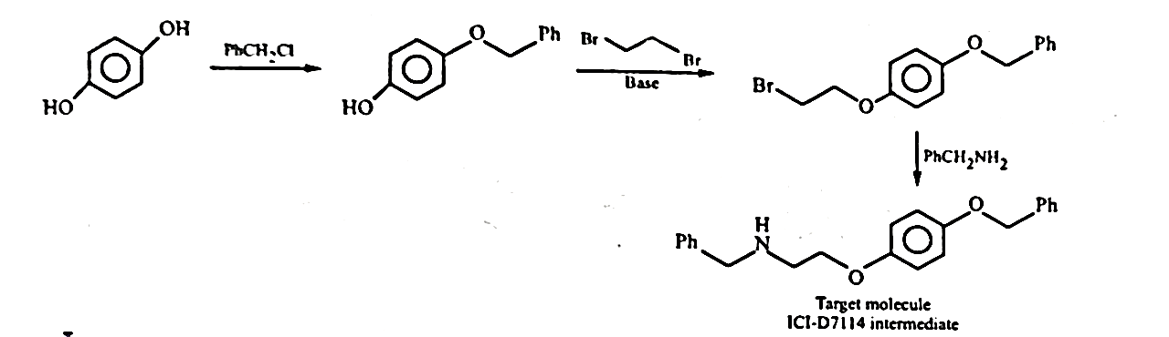
Synthesis

Slide 57


Slide 58

ELECTRONIC SPECTRA OF TRANSITION METAL COMPLEXES -I

Slide 59
Lecture Topics
Introduction
Electronic configuration
Quantum numbers
Spin - orbit coupling --- types
Term and state notation
Derivation of Term symbols,states & Microstates
Hund’s Rules
Table of higher energy terms and ground term for d1 to d9 configurations
Determination of ground term for metal ions in strong ligand field.

Slide 60
Introduction
Most of the transition metal complexes are colored.
For example Hexa aquo cobalt (II) ion is pink in colour and Tetra chloro cobaltate (II) ion is blue.
The spectral or magnetic properties of complexes are due to the presence of Unpaired electrons.
The unpaired electrons in the d - orbitals of metal ions are responsible for these spectral properties i.e., colour

Slide 61
Transition of electrons from one d- orbital to other is responsible for the spectral band.
These transitions are known as d-d transitions.
Similarly f-f transitions are possible Lanthanide and Actinide complexes.
These d-d and f-f transitions are combinedly known as ligand field spectra.
Splitting of d- orbitals or f- orbitals is possible in the presence of ligand field and hence transition from one low energy orbital to other high energy orbital is possible.

Slide 62
In addition to this ligand field spectra, the other types of spectra possible in complexes are
Charge Transfer spectra ( MLCT and LMCT).
Intraligand transitions.
Counter ion Spectra.
These three spectral studies are possible in UV region.
Ligand field transitions are possible mostly in Visible region and rarely in UV region.

Slide 63
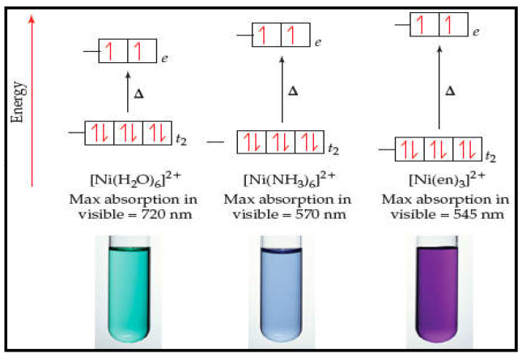
The study of ligand field spectra is confined to visible region only.
Color of the complex is due to complementary wavelength and not due to absorbed wavelength.
Color of the complex depends on the amount of energy absorbed, which in turn depends on crystal field or ligand field strength.

Slide 64
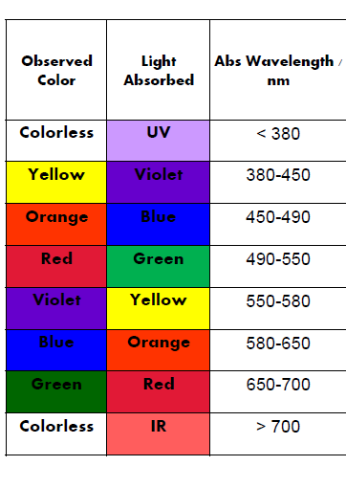
The adjacent table shows the list of absorbed wavelength and complimentary colour of the complex i.e., observed colour.

Slide 65
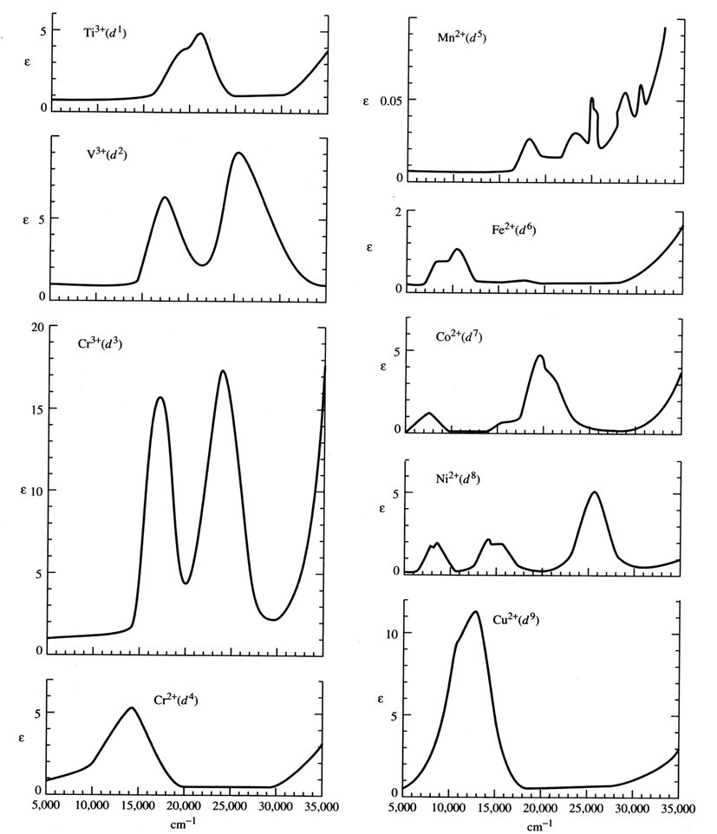
Analysis of these spectra is not simple and lot of theoretical knowledge is required

Slide 66
Theoretical knowledge of the following aspects is required to assess the possible number of bands and their intensity in the spectrum.
Number of possible energy levels.(Terms, states or ligand field components)
Energy ordering of the levels.(Hund’s rules to predict ground term and energy level diagrams i.e., Orgel or TS diagrams.)
Allowed transitions between these levels. (Quantum mechanical restrictions or Selection rules i.e., Spin selection rule and Laporte selection rule.)

Slide 67
Energy Levels
To derive the number of possible energy levels it is necessary to have the knowledge of Electronic configuration and Quantum numbers.
Electronic configuration : Electrons are arranged in the orbitals basing on Aufbau’s principle, Hund’s rule and Pauli’s exclusion principle.
Quantum numbers : Basically there four quantum numbers
Principal QN (n)
Azimuthal or Orbital angular momentum QN (l)
Magnetic QN (m_{l})
Spin QN (s)

Slide 68
In addition to these four basic QN three more are possible as per Vector Atom Model, which are
Total Orbital Angular Momentum QN (L)
Total Spin QN (S)
Total Angular Momentum QN (J)
Total Orbital Angular Momentum QN is obtained from vectorial summation of Azimuthal QN (l)
L = | l1 + l2 | ……………. …..| l1 - l2 | and can be shown as follows

Slide 69
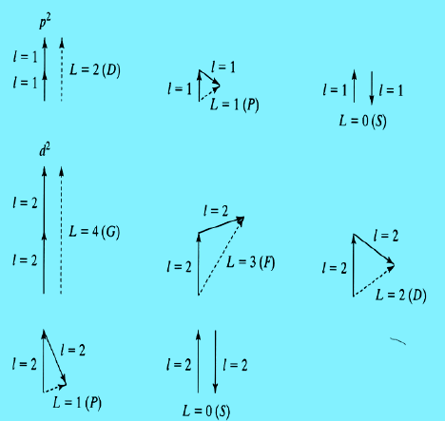

Slide 70
Total Spin QN (S) is obtained by the vectorial addition of individual electron spin Values.
S = | s1 + s2 | ……………. …..| s1 - s2 |
For example if there are two electrons in p orbital i.e., for p2 configuration the possible Total Spin QN (S) values are |½ + ½ | to |½ - ½ | and therefore the possible S values are 1 and 0.
Similarly for d2 configuration S values possible are 1 and 0

Slide 71
If s is spin quantum number then the possible orientations of which can be given by ms
Suppose if s=½ then possible ms values are +½ and -½ .
If s=1 them possible ms values are +1, 0, and -1.
In case of Total Spin QN S, the possible orientation of it can be written as Ms.
If S = ½ then possible Ms values are +½ and -½
Similarly if S = 1 then possible Ms values are +1, 0 and -1

Slide 72
In case of Azimuthal QN l , the possible orientation of this vector are given by ml
For example if l = 1 then possible ml values are +1 , 0 and -1.
Similarly in case of Total Orbital Angular Momentum QN L the possible orientations of it is given Ml
If L= 1 then possible Ml values are +1 , 0 and -1

Slide 73
Total Angular Momentum QN (J)
The vectorial Coupling of L and S will result in J values.
This L-S Coupling is known as spin - orbit coupling,
Spin - Orbit coupling is of two types,
L-S coupling which is also known as Russel - Saunders coupling
This sought of coupling is possible in lighter atoms i.e., transition
metal ions
l - s coupling possible in heavier atoms i.e., innertansition metal ions

Slide 74
The coupling of l and s results in j values. I.e., coupling of individual electron spin and orbital angular momentum.
Coupling of j - j results in J value and this type of coupling is complicated.
It is possible in elements heavier than bromine atom.
This sought of coupling is quite common in inner transition elements.

Slide 75
Term : A term is an energy level of an atomic system specified by an electronic configuration.
Thus configuration gives rise to several terms.
Electronic configuration IER Terms L-S States Zeeman or Stark Microstates
Microstate : It is an energy level with specific ml and ms value.
Formula to calculate no of microstates is {4l + 2}! / q ! {4l + 2-q} !
Where l is azimuthal QN of the orbital and q is number of electrons.

Slide 76
Electronic configuration splits into further energy levels due to the two perturbing forces.
InterElectronic Repulsions (IER)
Spin Orbit Coupling (L-S)
The magnitude of IER > L-S coupling.
Hence IER first acts on configuration and splits configuration into Terms.
Then Spin Orbit Coupling acts on Terms and splits them into states.

Slide 77
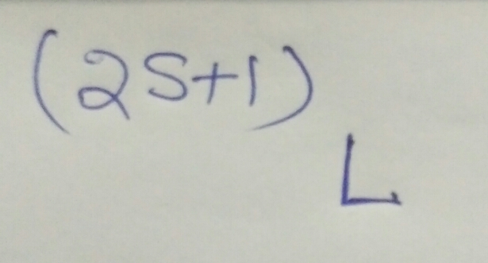
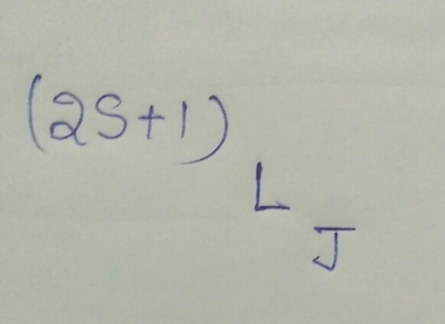
Term is designated as
State is designated as
( 2S + 1) is Known as Spin Multiplicity
In place of a symbol is going to be written depending on L value
J is resultant of L-S coupling

Slide 78
Azimuthal Quantum number and Corresponding orbital
Similarly the possible symbol for corresponding L value
l value | 0 | 1 | 2 | 3 | 4
Orbital | s | p | d | f | g
L value | 0 | 1 | 2 | 3 | 4 | 5 | 6
Symbol | S | P | D | F | G | H | I

Slide 79
Derivation of Term Symbols
It is possible to derive starting from configuration of the metal ion or starting from microstates arrangement.
In case of p1 configuration there is only one electron. Therefore l value is 1.
There is no second electron to couple with and hence L value is also 1
Similarly spin value s is ½ and therefore S is also ½.

Slide 80
L=1 and S=½ . The term notation is ²P
The possible J values are | L+S| …. To…. |L-S|
Hence J= |1+½ | …. To …. | 1- ½ |
I.e., J = 3/2 and ½
Therefore the possible states are ²P_{3/2} and ²P_{1/2}

Slide 81
Starting with microstates for p¹ configuration
The maximum possible Ml value is +1 and hence possible L value is 1 and therefore symbol is P.
As S value is ½ and therefore (2S+1) is 2.
The possible term is ²P and the possible states are ²P_{3/2} and ²P_{1/2}
+1 | 0 | -1 | Ml | Ms
 |  |  | +1 | +1/2
 |  |  | 0 | +1/2
 |  |  | -1 | +1/2
 |  |  | +1 | -1/2
 |  |  | 0 | -1/2
 |  |  | -1 | -1/2

Slide 82
Derivation of Term symbols of p² Configuration
Azimuthal QN for p orbital is 1 and hence each electron can be considered as a vector.
Therefore l ₁ is 1 and l ₂ is 1. L = | l ₁+ l ₂| ------- to ----- | l ₁- l ₂|
L = |1+1| ----- to ------ |1-1| i.e., L = 2, 1, 0
S₁ is ½ and S₂ is ½ and hence S = 1,0
The following possibilities will exist

Slide 83
L=2 , S=1 ³ D Not allowed as it violates Paulis Exclusion Principle | L=2 , S=0 ¹ D and state is ¹ D₂ ₍₅₎ Allowed term
L=1 , S=1 ³ P and states are ³ P_{2,} ³ P_{1,} ³ P₀ . Allowed | L=1 , S=0 ¹ P Not allowed
L=0 , S=1 ³ S Not Allowed | L=0 , S=0 ¹ S allowed and state is ¹ S₀

Slide 84
The allowed terms for p ² configuration are ¹ D, ³ P and ¹ S
States are
¹ D₂, ³ P₂, ³ P₁, ³ P₀ and ¹ S₀
5, 5, 3, 1 and 1 are no microstates possible

Slide 85
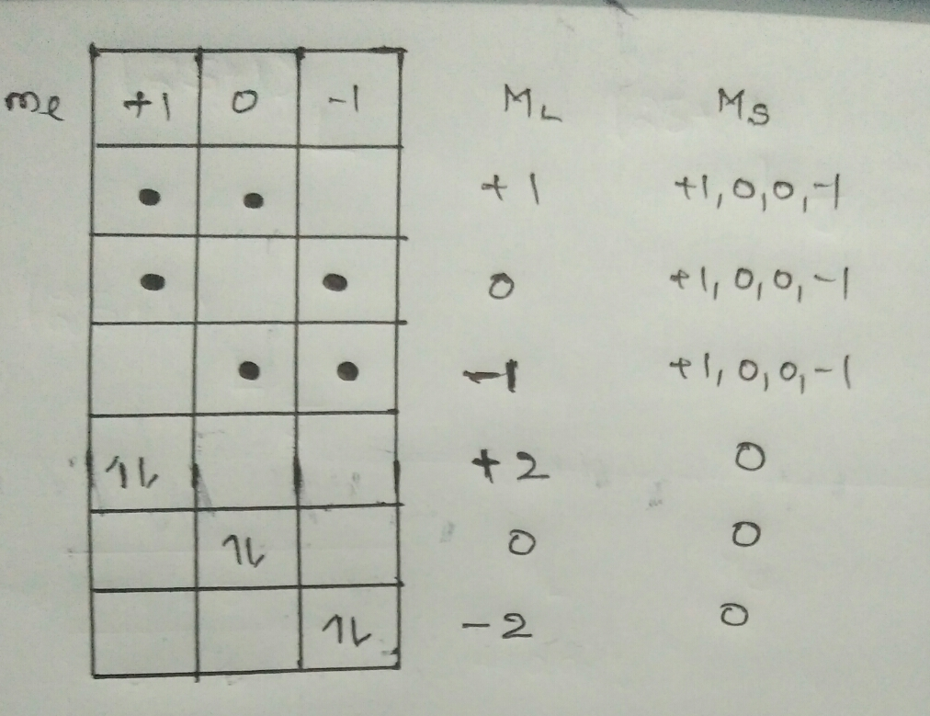
Derivation stating from microstates

Slide 86
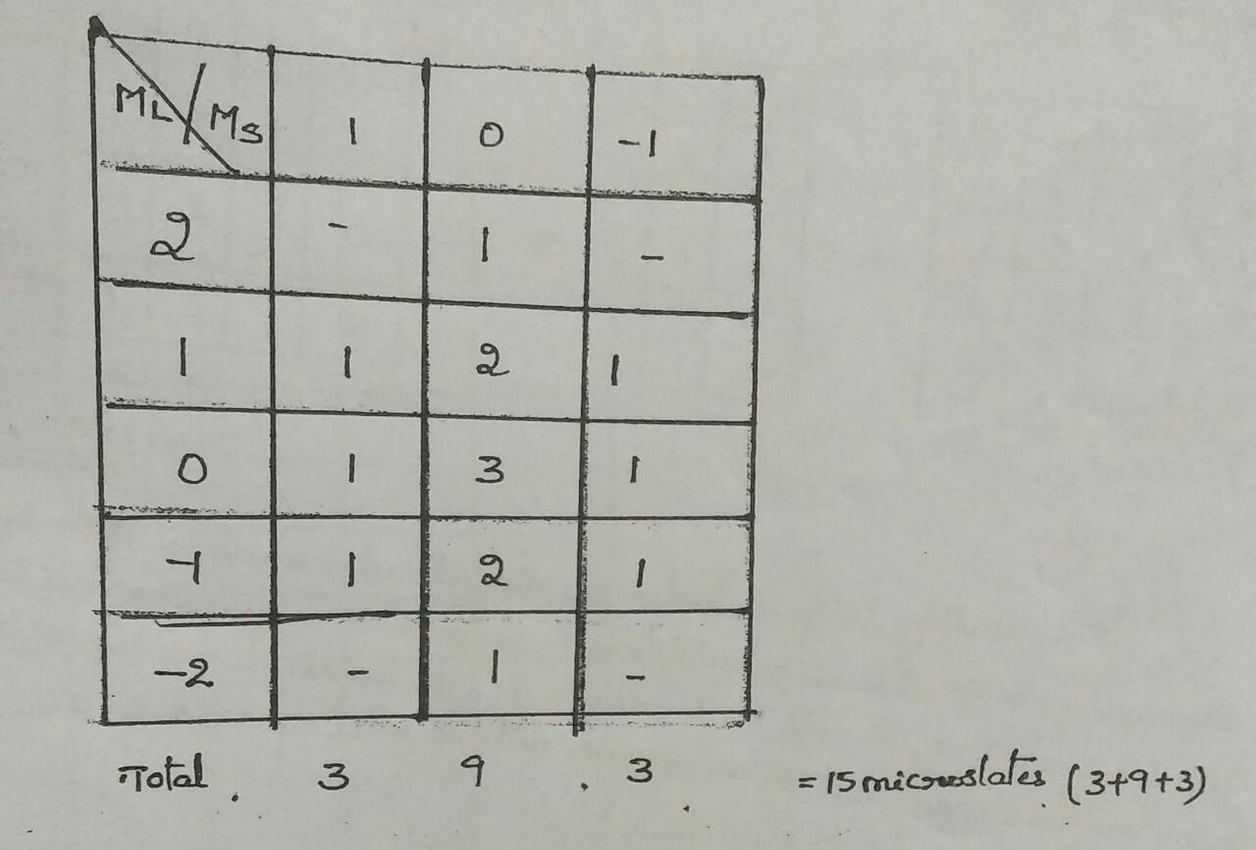
The maximum possible Ml value in this summary table is +2 and therefore L value is 2.
With Ml value +2 , arrangement is possible only for Ms = 0.
Hence S= 0
The possible term symbol is ¹ D and state is ¹ D ₂ for which 5 microstates are possible
Summary Table

Slide 87
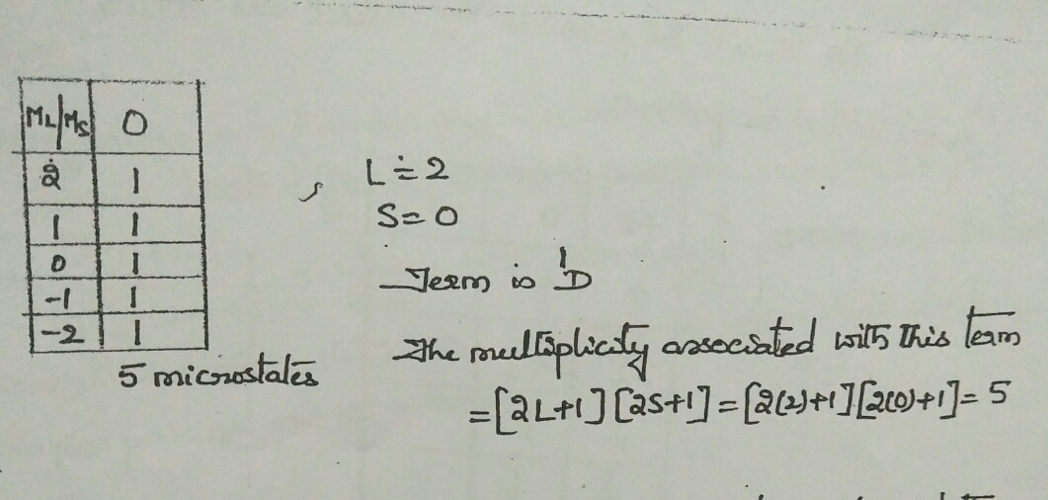
Microstates of ¹ D_{2 .}term are as follows

Slide 88
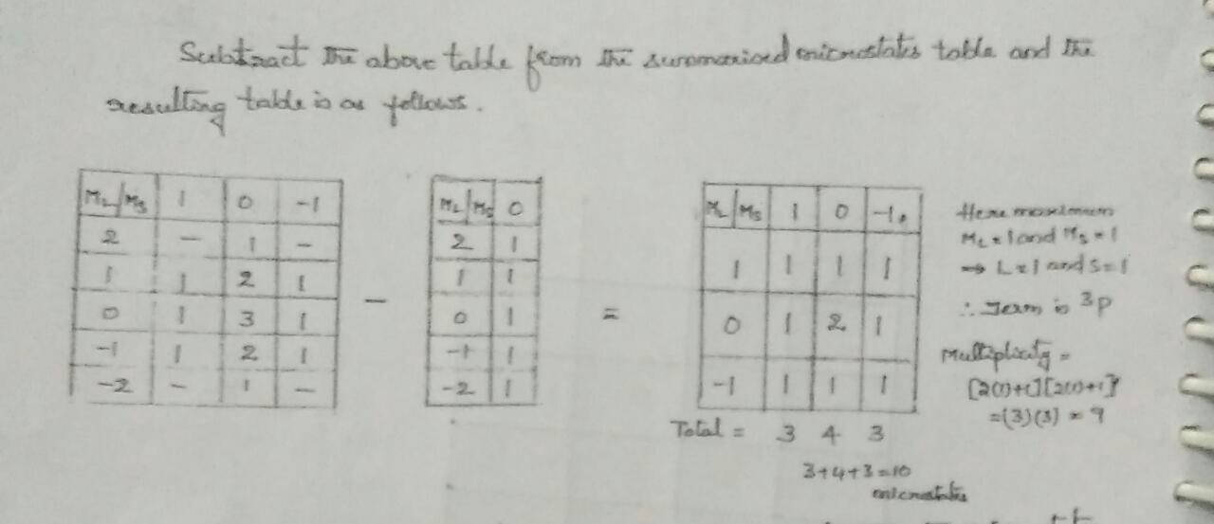
Left over table

Slide 89
Derivation of Next term from the left over summary table

Slide 90
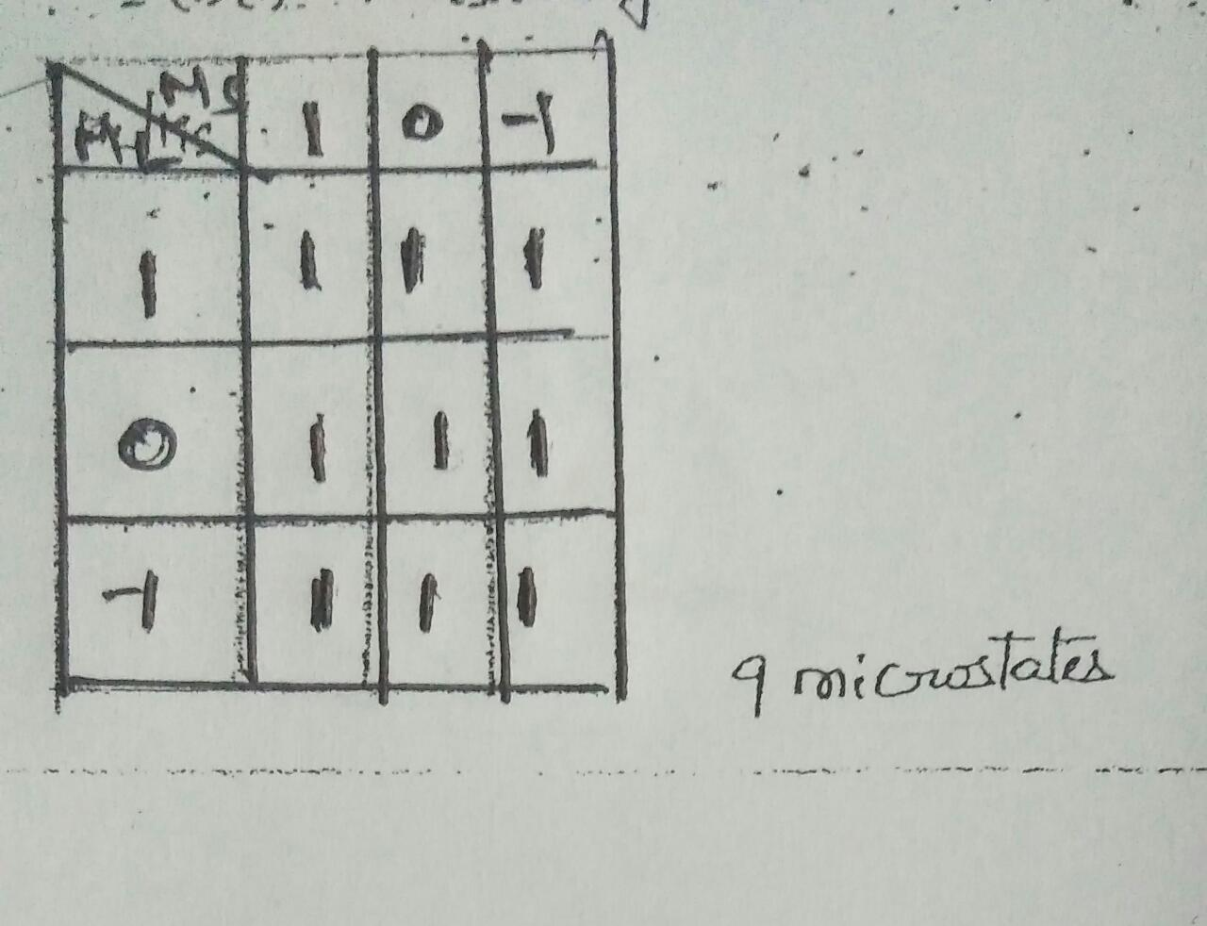
Microstates possible for ³ P

Slide 91
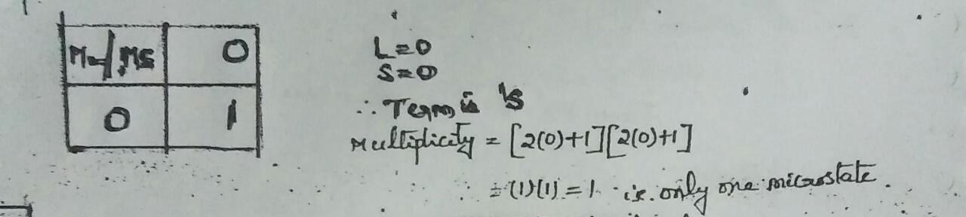
Final possible term derivation

Slide 92

Similarly terms can be derived for d¹ and d² configurations also.
The possible terms which can assign 45 microstates of d ² configuration are

Slide 93
Hund’s Rules to determine ground term and state
The ground state term to interpret the spectra of transition metal complexes. This can be obtained without constructing a microstate table.
The ground state will
State with maximum spin multiplicity
State with maximum L value
If there are two or more states with same S and L values then
the state with lowest J value will be the ground state if config is LT HF
the state with highest J value will be the ground state if config is GT HF

Slide 94
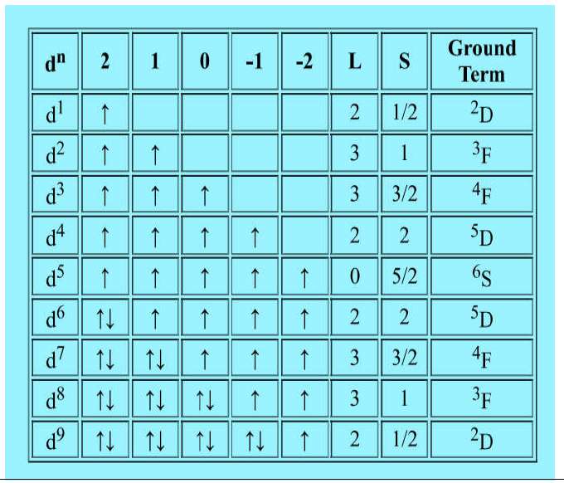
The following procedure can be adopted basing on Hund’s rules to derive the ground term

Slide 95

Higher Energy and ground energy terms for d ^{n} configurations

Slide 96


Slide 97
FORMATION OF CARBON – CARBON DOUBLE BONDS
Importance of formation of carbon-carbon double bond:
Allows the introduction of wide variety of functional groups
By
Dr T N V S S Satyadev
Ref: MODERN METHODS OF ORGANIC SYNTHESIS by William Carruthers

Slide 98
Pyrolytic elimination or syn eliminations
The term pyrolytic elimination literally means an elimination reaction occurring in the organic substrate due to the application of heat (Greek word pyr meaning fire). Pyrolytic eliminations do not require any additional reagent or solvent to occur, and mostly carried out in the gaseous phase though can be performed in inert solvents. Thus, these type of eliminations are different from other types of eliminations (E1,E2 or E1cB) as all other types of elimination reactions require an added base (external base or solvent) to proceed. These thermal elimination reactions of molecules can also be termed as pyrolytic Ei (Elimination internal) reactions.
Pyrolytic eliminations are an important group of alkene-forming reactions, by thermal decomposition.
The pyrolytic decomposition of carboxylic esters, xanthates, amine oxides, sulfoxides and selenoxides under high temperature to form carbon-carbon double are commonly known examples of pyrolytic elimination.
These reactions take place in a concerted manner, by way of a cyclic transition state (five or six membered TS) and therefore proceed with syn stereochemistry, such that the hydrogen atom and the leaving group depart from the same side of the incipient double bond.
Or Some substrates such as esters and amine oxides do not require any external agent for elimination. Simply heating such substrates provides elimination product. These reactions are known as pyrolytic Elimination.

Slide 99


Generalized mechanism

Slide 100

Based on the position of the leaving group, these may be α-eliminations, β-eliminations or
1,3/1,n-eliminations, among these the β-pyrolytic eliminations are the most common.
α-eliminations involve elimination of two leaving groups connected to the same carbon and encountered where the more common β-elimination is not possible. For example

Slide 101

β-eliminations occur when two groups are lost from adjacent carbons and as mentioned, constitute most of the pyrolytic eliminations with a typical Ei mechanism.
Carboxylic ester elimination

Slide 102
1,3 and 1,n- pyrolytic eliminations may also take place. For example
The other type of pyrolytic elimination reaction involves free radicals, for example in polyhalides and primary monohalides. Free radical eliminations involve the normal sequence for radical reactions, namely: initiation, propagation and termination steps and are frequent at 600-900 ºC temperatures.

Slide 103
The pyrolytic Ei elimination mechanism
Evidences for this mechanism are:
First order reaction kinetics.
No reaction intermediate has been isolated, suggesting it to be a concerted mechanism.
Free radical inhibitors show no effect on the reaction (no free radical mechanism involved).
Moreover, these eliminations show a negative entropy of activation which advocates that the transition state has a more restricted geometry (consequences of a cyclic transition state).

Slide 104

5. Exclusive syn elimination as demonstrated experimentally in various substrates with the use of radio-labelling techniques. For example, the pyrolysis of the erythro and threo isomers of 1-acetoxy-2-deutero-1,2-diphenylethane gave in each case trans-stilbene but, the stilbene from the erythro compound retained all the deuterium while the threo compound lost all of it.
Threo
Erythro

Slide 105


Aspects of pyrolytic Ei eliminations in acyclic systems
Pyrolysis of 2-butyl acetate affords a mixture of 1-butene, cis-2-butene, and trans-2-butene, with the trans/cis ratio around 2 (since there is less steric interaction between the two methyl groups in the transition state leading to the trans-alkene).

Slide 106

In cyclic compounds some restrictions are imposed by the conformation of the leaving groups and the necessity to form the cyclic transition state. Thus, the acetate (cis), in which the leaving group is axial, does not form a double bond in the direction of the ethoxycarbonyl group, even though it would be conjugated. In contrast, the trans-diastereomer can adopt the necessary cyclic transition state that leads to the conjugated alkene

Slide 107

Thus, we can generalize these observations as:
1. When leaving group is axial, it cannot attain a cyclic transition state with a neighboring axial hydrogen.
2. When the leaving group is equatorial, it can form the cyclic transition state with either an equatorial (trans-relationship) or axial (cis-relationship) with a hydrogen atom at adjacent carbon as can be seen in the following example of methylcyclohexyl xanthate.

Slide 108

Free radical pyrolytic elimination mechanism
Free radical elimination is found in polyhalides and primary monohalides. The steps are similar to any free radical reaction, i.e. there is an initiation step, followed by several propagation steps, and then finally there are termination steps. A schematic representation of the free radical elimination mechanism is as shown below.

Slide 109
Scope and synthetic importance of pyrolytic elimination.
Pyrolytic eliminations occur in a variety of substrates containing appropriate leaving groups and are important from a synthetic perspective.
Ester Pyrolysis
The pyrolysis of esters is usually affected at high temperatures (300-500 ºC).

Slide 110

A case in point is, diacetate(I) gives 1,2-dimethylene cyclohexene which otherwise difficult to prepare. It tends to aromatize to o-xylene.
Chugaev elimination of Xanthates and Thionocarbonates
The Russian chemist Lev Aleksandrovich Chugaev (1899) discovered a way to eliminate water from alcohols to produce alkenes via the formation of an intermediate xanthate and this methodology came to be known as Chugaev reaction.

Slide 111

Since these related thiocarbonates or xanthates eliminate at temperatures in the region of 150– 250ºC, this reaction is of immense synthetic potential than ester pyrolysis as further decomposition of the alkene product(s) can often be avoided.
At about 150-200 °C, the alkene is formed by a syn-elimination through a 6-membered cyclic transition state. The side product decomposes to carbonyl sulfide (OCS) and methanethiol.

Slide 112
The Cope Elimination of tert-amineoxides
The Cope elimination, developed by Arthur C. Cope, is an elimination reaction of the N-oxide of a tertiary amine to form an alkene and a hydroxylamine at milder reaction temperatures (100-200 ºC). This reaction provides an alternative to Hofmann elimination of the quaternary ammonium salts. The N-oxide can be easily prepared in situ from tertiary amines with an oxidant such as m- CPBA or H₂O₂.

Slide 113
The Cope elimination is also a syn-elimination and involves a five-membered cyclic transition state which must be planar (syn-coplanarity). The amine oxide (leaving group) itself acts as a base. The net reaction is 1,2-elimination.

Slide 114
The sterically demanding amine-oxide reacts preferentially with the more easily accessible hydrogens, and often gives good selectivity favouring the less-substituted alkene. Thus, Cope elimination is region selective and for simple alkenes, the reaction follows the Hofmann Rule.
The following structures exemplify the stereochemical requirement for reaching a five membered cyclic transition state and the influence of sterically demanding groups for some cyclic compounds. Thus, heating dimethylmenthylamine oxide gave a mixture of 2- and 3-menthene, whereas the isomeric neomenthylamine oxide gave only 2-menthene.

Slide 116

Another remarkable difference between Cope elimination and ester or xanthate pyrolysis is exemplified by the example of 1-methyl-cyclohexyl derivatives as shown. Cope elimination results in the exclusive formation of methylene cyclohexane which is attributed to the formation of a five-membered cyclic transition state that allows preferential abstraction of a hydrogen atom from the methyl group, whereas with the more flexible six-membered transition state of the ester or xanthate pyrolyses, hydrogen atom abstraction is also possible from the cyclohexyl ring. However, with larger, more-flexible rings, the cycloalkene is the major product from the amine oxides or the esters.

Slide 117

Sulfoxide containing substrates
Sulphur and selenium belong to the same group (periodic table) and show valences from 2 to 6. An organic sulphide is oxidized to sulphoxides and to some extent sulphones. sodium periodate and hydrogen peroxide are commonly employed for sulphide-sulphone reaction. Sulphoxides containing β-hydrogen undergo syn-elimination on heating to give an olefin.
Oxidation of the sulphide, followed by heating of the sulphone introduces a double bond. the reaction involves a 5-membered T.S. as in other cases.

Slide 118

Pyrolysis of selenoxide
It was discovered that for superior results can be obtained using alkyl phenyl selenoxides in place of sulphoxides. The merits of the method are:
It is a very mild method. The selenoxide elimination occurrs even at room temperature or below. Sometimes elimination taking place during oxidation step itself.
The selenoxide need not be isolated
The elimination is Syn-elimination reaction.
It involves a 5-membered cyclic T.S.
Good yields and wide scope.
Alkyl Phenyl selenides (First Step) are accessible by a variety of method.

Slide 119

Alkenes from sulphones:
The alkenes are prepared from a-halo sulphones on treatment with base ( the Ramberg- Backlund reaction) with extrusion of sulphur dioxide from an episulphone.

Slide 120

Sulphones can be used to make alkenes through corresponding 2-lithio derivatives. These react readily with aldehydes (or) kelones to give a-hydroxy sulphones in form of their acetates (or) P-toulene sulphonates and undergo smooth reductive cleavage with södfum amalgam in melhanol to form alkenes.
The reaction is region selective and can be used to prepare di, ti and tetra substituted alkenes and conjugated dienes.

Slide 121

Reductions leading to 1,2 – di substituted alkenes give very largely E- isomer, irrespective of configuration of hydroxyl sulphone..
Z- alkenes can be obtained from dehydration of hydroxyl sulphone, instead of reductive elimination.

Slide 122

The Z and E – sulphones can be obtained selectively from appropriate threo and erythro hydroxyl sulphones. On reductive cleavage of sulphone by reaction with alkyl Grignard reagent in the presence of Ni (or) Pd catalysts give corresponding 1,2 – di substituted alkene with high retention of stereochemistry. The E- sulphone gave Z- 2 duodecene in 85 % yield.

Slide 123

Sulphoxide – Sulphenate rearrangement – synthesis of allyl alcohols
Allylic sulphoxides on gentle warming are converted into rearranged all sulphenate esters by a reversible reaction. The equilibrium is usually much in favour of sulphoxide, but if mixture is treated with thiophile (trimethyl phophite and diethyl amine are often used) is irreversibly converted into allylic alcohol. Even in sulphenate is present in low concentration with sulphoxide, its removal by reaction with the thiophile results in conversion of the sulphoxide into the rearranged allyl alcohol in high yield.

Slide 124

The alkylation of sulphoxide provides a versatile synthesis for di and tri substituted allylic alcohols. In acyclic series the rearrangement step is highly stereoselective leading to the trans allylic alcohol mainly.

Slide 125


In this series of reaction the anion derived from sulphoxide is equivalent to vinyl anion.

Slide 126

Oxidative decarboxylation of Carboxylic acids
Oxidative decarboxylation of carboxylic acids is one the most useful methods for generating carbon – carbon double bond.
The familiar procedure in this method involves the use of lead tera acetate in boiling benzene. This procedure results in poor and variable yields and it is not applicable to bicyclic diacids with nearby double bonds. However improved results are obtained in the presence of oxygen.

Slide 127


A better procedure involves electrolysis of acid in pyridine solution in the presence of trimethyl amine. This method provides good yield and proceeds under mild conditions. This is an attractive procedure for preparing highly strained unsaturated small and bridged ring compounds.
Eg: Dewar benzene is synthesised by this route from bicycle [2,2,0] hex – 2 –ene- 5,6 – dicaboxylic acid.

Slide 128


Another method is thermal or photolytic decomposition of di – t- butyl per esters which are readily obtained from di – acid chlorides and t- butyl hydroperoxides. This photolytic process can be used for the synthesis of thermally labile alkenes.
The oxidative decarboxylation of monocarboxylic acids with LTA under ordinary conditions result in poor yields and mixture of products. In the presence of catalytic amount of copper (II) acetate, primary and secondary carboxylic acids yield alkenes, either photochemically or thermally in boiling benzene.

Slide 129

The following radical chain mechanism is proposed.
RCO₂Pb^{III} $→$ R. + CO₂ + Pb (II)
R. + Cu(II) $→$ Alkene + H⁺ + Cu (I)
Cu (I) + RCO₂Pb^{IV} $→$ Cu (II) + RCO₂Pb^{III} etc.
Aromatic acids react with lithium and ammonia and alkylated directly by reaction with an alky halide. The resulting dihydroaromatic carboxylic acid is decarboxylated with LTA regenerating the aromatic nucleus. However the carboxyl group is now replaced by an alky group.

Slide 130

Eg: Rose furan was obtained from 3-methyl -2- furoic acids

Slide 131

Fragmentation Reactions
Fragmentation reactions, which are similar to β – eliminations reactions are very much useful for the formation of alkenes. These reactions have less general applications, but are valuable in particular circumstances.
The fragmentation of monotoluene –p – sulphonates or methane sulphamates of suitable cyclic 1,3 – diols on treatment with a base. Fragmentation reactions occur most easily from coformationally locked 1,3 – difunctionalised compounds. In these the breaking C-X and C-C bonds are aligned antiperiplanar.

Slide 132

Eg: The decalin derivative in which the tosyloxy group and the adjacent ring junction hydrogen atom are cis, gave E-5-cyclodecenone in high yield.

Slide 133

Whereas the isomer, in which the tosyloxy group and the hydrogen atom are trans, gave the Z- isomer.
In the above two cases, the relative orientation of the hydrogen atoms in the precursor is retained in the alkene. In these derivatives, there is an antiperiplanar arrangement of the breaking bonds. But, however in the following isomer on treatment with base, gave a mixture of products containing only a very small amount of the E- Cyclodecenone.

Slide 134


The borate species formed by hydroboration (on the less hindered face) of the alkene, followed by nucleophilic addition of hydroxide, fragments to the diene.

Slide 135

Alkenes from aryl sulphonyl hydrazones
Alkenes are readily prepared from aliphatic and alicyclic ketenes with at least one α – hydrogen atom by reaction of the toluene – p- sulphonyl hydrazine with two equivalents of an alkyl lithium (lithium diisopropyl amide). The reaction proceeds under mild conditions without rearrangement of the carbon skeleton to give the substituted alkene.
Pinacalone gives exclusively 3,3 – dimethyl – 1 – butane and phenyl acetone to give 3- phenyl propene and not the corresponding styrene.

Slide 136

The reaction proceeds by way of dianion which rapidly fragments to the lithio derivative. But, yields of alkene obtained in TMEDA (tetramethyl ethylene diamine) as solvent or in the presence of TMEDA less substituted alkene from an unsymmetrical ketene.

Slide 137
In ethanol solvents the position of the double bond of alkene produced is determined by the stereochemistry of hydrazine. Abstraction of second proton from anion (65) takes place syn to the ArSO₂N⁻ - (arylsulphonamido anion). The vinyl lithium intermediate (67) can be trapped with a variety of other electrophiles besides protons giving a range of substituted alkenes including vinyl bromide, acrylic acids and allyl alcohols.
There is an advantage of using 2,4,6 – triisopropyl benzene sulphonyl hydrazine as the source of vinyl lithium.

Slide 138


Slide 139

Quenching the reaction mixture with deuterium oxide (D₂O) provides an excellent method for the preparation of specifically deuterated alkene.
Eg: 2- methyl cyclohexanone was converted to 2 – deuterio -3- methyl cyclohexene.
The reduction of carbonyl tosyl hydrazones to alkenes (hydrocarbons) with NaCNBH₃ in acidic media or with catechol borane is a mild and selective alternative to Wolf - Kishner deoxygenation. The reaction proceeds by a diazo intermediate followed by 1,5 – migration of the hydride from nitrogen to carbon.

Slide 140

Reduction with sodium borodenteride in acetic acid or carbonyl deuterated acetic acid results in the region selective introduction of one or two deuterium atoms respectively. In deuterated acetic acid exchange of the N-H proton of the tosyl hydrazone must be faster than reduction and H⁻ transfer to carbon.

Slide 141

Decarboxylation of β – lactones
Decarboxylation of β – lactones provide an important route for the synthesis of alkenes. β – Lactones decompose readily at 140-160⁰C (moderate temperature) to alkenes and carbon dioxide. These β – lactones can be prepared from β – hydroxy acids by the action of benzene sulphonyl chloride in pyridine.

Slide 142
β – hydroxy acids can also be prepared by Reformatsky reaction or by condensation of α – metalated carboxylic salts with aldehydes and ketones. This reaction is alternative to wittig reaction and very useful for the synthesis of tri and tetra substituted alkenes.
The β – lactones are formed stereospecifically with retention of the geometry of the β – hydroxy acid. The decarboxylation step is also stereospecific. Stereochemically pure β – hydroxy acids give stereochemically pure alkenes.
When the β – hydroxy acid is obtained as a mixture of threo and erythro isomers, reaction gives a mixture of Z and E alkenes.
Threo β – hydroxy acids are obtained by the addition of bis lithio anions of carboxylic acids to aldehydes. This β – hydroxy acid undergoes anti elimination on treating with triphenyl phosphine and diethyl azo dicarboxylate giving the Z alkene. In this reaction zwitter ion is formed which undergoes fragmentation with the loss of carbon dioxide and triphenyl phophine oxide with anti-stereochemistry.

Slide 143

In syn elimination E- alkene is formed by β lactone procedure.

Slide 144

Reductive dimerization of carbonyl compounds
Alkenes can be obtained from aldehyde or ketone on reductive dimerization by treatment with a reagent prepared from titanium (III) chloride and LAH or zinc copper couple or with a species of active titanium metal formed by reduction of titanium (III) chloride with potassium or lithium.
The reactions are widely useful, but in intermolecular reaction a mixture of Z and E – alkenes are produced.

Slide 145
The reaction takes place in two steps on the surface of active titanium particles.
The first stage is formation of new c-c bond by simply a pinacol reduction. The titanium reagent donates an electron to carbonyl compound generating a ketyl which dimerises to give pinacol. The pinacol intermediary pinacol is supported by the fact that they are smoothly converted into alkenes on treatment with the titanium reagent.
In the second stage deoxygenation of pinacol on the surface of the titanium particles results in the cleavage of the two c-o bonds give alkene and oxidised titanium surface.

Slide 146


Slide 147
Mixed coupling reactions using two different carbonyl compounds generally lead to mixture of products and are of less use.
Intermolecular reactions of dicarbonyl compound provide a good route to cyclic alkenes containing 4 to 16 carbon atoms.
Eg: The following keto aldehyde gave the 15 membered cyclic diterpene flexibilene.

Slide 148


Slide 149

Conversion of ketoesters to cyclic ketones.
The unusual E to Z – isomerization of the double bond is due to the strain in the cyclic intermediate in which two oxygen atoms are bound to titanium.

Slide 150

The Wittig Reaction
The reaction between a phosphorane or phosphonium ylid, and an aldehyde or ketone to form a phosphine oxide and an alkene is known as Wittig reaction. A German chemist Georg Wittig has developed this procedure for the synthesis of alkenes. The reaction is easy to carry out and proceeds under mild conditions. Pyrolytic eliminations result in alkenes in which the position of the double bond is uncertain or not clear. It is not so in case of Wittig reaction.

Slide 151
The reaction generally leads to high yields of di, and tri substituted alkenes from aldehydes and ketones.
Due to steric effects, yields of tetra substituted alkenes from ketones are poor.
The presence or addition of hexamethylphosphoramide or a catalytic amount of crown ether to the reaction medium or if reaction is carried out at higher temperature than usual in refluxing benzene or toluene with sodium t- amylate as base makes the reaction slow.

Slide 152


Phosphoranes are resonance stabilised structures in which there is some overlap between the carbon p orbital and one of the d- orbitals of phosphorus.

Slide 153

Reaction with a carbonyl compound takes place by attack of the carbanionoid carbon of the ylid form on the electrophilic carbon of the carbonyl group with the formation of betaine which collapses to the products by way of a four membered cyclic transition state. The driving force for this is provided by the formation of the very strong phosphorus – oxygen bond.

Slide 154
The rate determining step in this reaction is either first step or second step. The last step is never a slow step. There is some uncertainty in considering the four membered ring as either true intermediate or transition state.
The reactivity of the phosphorane depends on the nature of the group R, R¹ and R².
In general R is always phenyl.
The formal positive charge on the phosphorus is reduced by the inductive effect of the alkyl groups in Alkylidene trialkylphophoranes and is more reactive than alkylidene triphenylphosphoranes in the initial addition to a carbonyl group to form a betaine.

Slide 155
The decomposition of betaine with alkylidene trialkyphophoranes is more difficult.
In the alkylidine part of the phosphorane , if R¹ or R² is an electron withdrawing group (e.g. CO or CO₂R) the negative charge in the ylid becomes delocalised into R¹ or R² and consequently the nucleophiic character, as well as reactivity towards carbonyl group is decreased.
Reagents of this type are much more stable and less reactive than those in which R¹ and R² are alkyl groups.
The carbalkoxymethylenetriphenyl phophorane react fairly readily with aldehydes, but give only poor yields in reaction with the less reactive carbonyl group of ketones.

Slide 156

Alkylidenephophorane can be prepared by a number of methods, but in practice they are usually obtained by action of base on alkyltriphenylphophonium salts, which are themselves readily available from an alkyl halide and triphenynlphosphine. The phosphonium salt can usually be isolated and crystallised but the phosphorane is generally prepared in solution and used without isolation.

Slide 157


Reactions involving non-stabilised ylids must be conducted under anhydrous conditions and in an inert atmosphere, because these ylids react both with oxygen and with water. On reaction with water, phophorane gets converted to phosphine oxide and a hydrocarbon. With, oxygen, reaction leads in the first place to triphenylphosphine oxide and a carbonyl compound. This carbonyl compound then undergoes a Wittig reaction with unoxidised ylid to form a symmetrical alkene. This is in fact quite a useful route to symmetrical alkenes.

Slide 158

Stereospecific synthesis from 1,2 – diols
The formation of double bonds from 1,2 – diols proceed by the decomposition of an intermediate.
One of the method involves the use of thionocarbonates that are obtained by the treatment of diols with thiophosgene. Reaction of thionocarbonate with 1,3 – dimethyl-2-phenyl-1,3,-diazophospholidine proceed by a concerted process or by way of an intermediate carbene.

Slide 159

This reaction is applicable to complex and sensitive molecules containing a variety of functional groups.
The reaction is stereospecific with syn elimination. This allows stereospecific synthesis of strained cycloalkenes with trans perhydroxylation which provides a general method for the interconversion of Z and E alkenes. In the following example Z- cyclooctene was converted into the E- isomer.

Slide 160
Stereo selective Synthesis of Tri and Tetra Substituted Alkenes
When compared to isomerically pure tri and tetra substituted alkenes E and Z 1, 2 – di substituted alkenes are readily available by reduction of alkynes as other means.
1. Reaction of Grignard reagent : α – Chloro aldehyde or ketone
The most reactive conformation of α – chloro ketone i.e., the group C=O group and C-Cl are antiparallel. Addition of Grignard reagent is highly stereo selective and takes place from the less sterically hindered side by the group R¹ and R² on α –carbon. R⁴ and larger of the groups R¹ and R² are anti to each other. Three groups on the alkene are derived from > C=O compound and one from Grignard reagent.

Slide 161



Slide 162

2. Stereospecific conversion of Propargylic alcohol
In this method 2 or 3 alkylated allylic alcohols are obtained. If reduction is affected in the presence of CH₃ONa exclusively γ – iodo allylic alcohol is obtained. In the presence of LAH and AlCl₃ β – iodo allylic alcohol is obtained. The resulting iodo compounds when treated with organo cuprates affords the corresponding substituted allylic alcohol. The substituents present are trans to each other in the product. This method is applicable to variety of synthetic problems in which stereospecific introduction of tri substituted C=C is involved.

Slide 163

3. By addition of organo copper and organo borane reagents to alkynes
Conversion of α, β acetylinic esters to β, β– dialkyl acrylic esters. Stereoisomeric acrylic esters are obtained in high yield.
Stereochemistry of the product depends on the reaction temperature and nature of the solvent. High yields of Z addition products are obtained in THF at – 78⁰C. In contrast to the above procedure substituents in the acetylinic precursor are cis to each other in the alkene.

Slide 164


4.Syn addition of organo copper (I) reagents to terminal alkynes to give 1- alkenyl copper (I) compounds
The alkenyl copper (I) compounds thus obtained reacts with a wide variety of electrophiles including alkylhalides, α,β- unsaturated ketones, epoxides giving trisubstituted alkenes with retention of configuration.

Slide 165

Conjugated dienes are also obtained in the presence of catalytic Pd(PPh₃)₄ by the reaction of alkenyl Cu(I) reagent with alkenyl iodides.

Slide 166

5. Stereospecific synthesis of alkenes from alkynes
a)Alkenyl alanes: Hydro alumination of alkynes with di isobutyl aluminium hydride takes place by cis addition to give z - alkenyl alane. Reaction of alkenyl alane with halogen proceeds with retention of configuration to give the corresponding alkenyl halide. The halogen atoms are replaced by alkyl groups by reaction with organo copper reagent.
Eg: 1-hexyne on iodination gives ( E ) – 1- iodo – 1 – hexene.

Slide 167

b)Alkenyl boronic acid: This is an excellent procedure for the formation of carbon-carbon double bonds.
This reaction results in the formation of Z and E – 1- halogeno alkenes from terminal acetylenes by using E- alkenyl boronic acid.
Terminal acetylenes react with catechol borane followed by hydrolysis to give E- alkenyl boronic acid.
Reaction of boronic acid with I₂ and NaOH results in the replacement of boronic acid group by iodine with retention of configuration. E-1- iodo alkene is obtained. The course of iodonation is not clear.

Slide 168


The reactions with Br₂ followed by treatment with base results in inversion of configuration to give Z-1- bromo alkenes. The inversion of configuration is accounted for the usual trans addition of Br₂ to the C=C followed by base induced trans elimination of B and Br₂.
Mechanism

Slide 169

6. Alkenyl alanes react with methyl lithium affords corresponding aluminates which are converted to α, β – unsaturated acids on combination with paraformaldehyde allylic alcohols are obtained (cis addition to triple bond , Zwiefel method).
In contrast to the above method reaction of acetylene with lithium hydrido di isobutyl methyl aluminate results in trans addition to the tripe bond. Thus all isomeric products are obtained in the reaction.

Slide 170

Alkenyl boranes do not behave in the same way as alkenyl alanes. On Iodonation they do not give the corresponding iodide but stereospecific transfer of one alkyl group from boron to the adjacent carbon takes place resulting in a substituted alkene.

Slide 171


This method has been extended for the synthesis of tri substituted alkenes from a di substituted alkyne. The original alkyne substituents are trans to each other in the product.
7. Tri substituted alkenes are also obtained from terminal alkynes by way of the corresponding 1 –a lkenyl iodides. Iodide from alkenyl iodide is replaced by borane with retention of configuration. The stereochemistry of the product requires syn elimination of R₂BI.

Slide 172

8. Tri substituted alkenes are also obtained by stereoselective epoxidation of allylic alcohols.

Slide 173

Claisen Rearrangement of Ally Vinyl Ethers
The Claisen rearrangement of allyl vinyl ethers provide a route to γ, δ – unsaturated carbonyl compounds from allyl alcohols. The reaction takes place by a [3,3] sigmatropic rearrangement in a concerted manner via 6 membered cyclic transition state.
This rearrangement has resulted in the formation of new C=C and C-C and the reaction is highly stereoselective.
When R¹ ≠H the nearly formed double bond has E – Configuration and the substituents on the single bond have controlled stereochemical disposition.

Slide 174

The transition state has chair conformation with substituent R² in equatorial conformation. The E – double bond is a result of non-bonded interaction between the substituent R¹ and R² in an alternative transition state which gives Z – alkene.
Preparation of allyl ethers:
The allyl vinyl ethers used in the reaction are prepared from allyl alcohols by acid catalysed ether exchange which on pyrolysis forms γ, δ – unsaturated aldehydes.

Slide 175
In the following case an allyl alcohol directly gave γ, δ – unsaturated ketone without isolation of the intermediate allyl vinyl ether.
γ, δ – unsaturated esters are obtained by heating allyl alcohols with methyl ortho acetate in the presence of weak acid. A mixed ortho ester is formed and lose of methanol to form ketone acetal which rearranges to γ, δ – unsaturated esters.

Slide 176

This reaction is unsuitable for compounds containing acid sensitive functional groups because high temperature is needed.

Slide 177

High yield of unsaturated acids are obtained (after hydrolysis of trimethyl silyl esters ) under mild neutral or weakly alkaline conditions resulting in E – double bond.
Valuable feature is the stereochemical control of the substituents on the newly formed single bond.

Slide 178

There are three chiral centres involved in the starting material and product. The reaction proceeds suprafacially with regard to the allylic fragment. The configuration at the allylic centre C– 3 is directly related to that of the starting material.
The configuration of the new chiral centre C-3 is obtained by changing the configuration of the allylic double bond in the starting material. One chiral centre is destroyed and a new one is formed in a controlled way at the allylic position of the product.

Slide 179
The relationship of the chiral C-2 to C-3 in the product established by the chair like transition state and depends on the geometry of the double bond in the starting material.
Eg: Isomeric 2- butenyl – 1 – propenyl ether.
This feature combined with suprafacial rearrangement allows the configuration of both the chiral centres at the newly formed single bond in the product to be related to the allylic hydroxyl group in the starting material by selecting appropriate geometry of the double bond.

Slide 180
PROTECTION AND DEPROTECTION OF FUNCTIONAL GROUPS
By
Dr T N V S S Satyadev,
Department of Chemistry,
P B Siddhartha College of Arts & Science, Vijayawada.

Slide 181
Introduction
An organic molecule may contain one or more functional groups in it.
If there are two or more functional groups in an organic molecule then all the groups are may not be of similar reactivity.
When there are two functional groups of unequal reactivity within a molecule, the more reactive group can be made to react alone, but it may not be possible to react the less reactive functional group selectively.
What is a protecting group?
“A group whose use makes possible to react a less reactive functional group selectively in the presence of a more reactive group is known as a protecting group”.

Slide 182

Theory and Importance of functional group protection and de-protection.
A protecting group or protective group is introduced into a molecule by chemical modification of a functional group in order to obtain chemo-selectivity in a subsequent chemical reaction. It plays an important role in multistep organic synthesis.
Eg: The tertiary alcohol 3 could be prepared from a keto-ester (acetoacetic ester) 1 if phenylmagnesium bromide is made to react with the less reactive ester goup than with the more reactive keto group.

Slide 183


As anticipated, simply adding phenylmagnesium bromide to acetoacetic ester, addition to the more electrophilic ketone mainly takes place.
The possible way to prepare the desired alcohol 3 is to protect the ketone as a ketal, i.e., a ketal protecting group (dioxolane) is used in this case.

Slide 184
The first step puts the protecting group on to the (more electrophilic) ketone carbonyl making it no longer reactive towards nucleophilic addition.
The Grignard reagent then adds to the ester, and finally a de-protection step (removal of the protecting group), acid catalysed hydrolysis of the ketal 2 gives the ketone carbonyl group back.
Eg 2: Lithium Aluminium Hydride is a highly reactive but useful reagent capable of reducing esters to alcohols. It will always react with carbonyl groups and this cannot be discouraged by any means.
When a reduction of an ester is required in the presence of a carbonyl, the attack of the hydride on the carbonyl has to be prevented. This can be achieved if carbonyl is converted into an acetal then it does not react with hydrides. The acetal is then called Protecting group for the carbonyl.
In the next step the use of LiAlH₄, reduces the ester group into alcoholic group. After successful reduction of ester group, the carbonyl group is regenerated by de-protecting using aqueous acid.

Slide 185


Slide 186
This concept can be easily illustrated by considering the synthesis of a desired dipeptide molecule from the starting amino acid molecules (the concept can be extended to polypeptide synthesis).
Let the dipeptide to be synthesized is…
H₂N – A – CO - NH – B - COOH (or abbreviated as AB)
Starting from H₂N – A – COOH (abbreviated as A) and H₂N – B – COOH (abbreviated as B) If one mixes together A and B and allow them to react, one can easily see that many other products such as BA, AA, BB, AAA, BBB, ABA, BAB, AAB will all be produced and the reaction will be a total loss. On the other hand, if the amino group of A and the acid group of B are blocked.
P₁-HN – A – COOH and H₂N – B – COO- P₂ (P₁ is PG protecting amine group and P₂ is PG protecting the acid group). Then only the acid group of A and the amino group of B are free to react, giving only the desired product AB. The protecting groups are removed after reaction.

Slide 187

In peptide synthesis, after introducing the protecting groups, the amide (or peptide) linkages are produced by reacting in presence of a coupling agent such as N,N-dicyclohexyl carbodimide (or DCC). The water molecule produced by the condensation of the amino and carboxylic acid group is absorbed by DCC. Which is converted to a urea derivative that can be easily removed.

Slide 188
The following features must be considered, when choosing a suitable protecting group. The protecting group:
  1) Must react easily with the functional group to be protected under mild conditions.
  2) Must be stable to the reaction conditions after protection.
  3) Must be easily removable when required without affecting other parts of the molecule.
The protecting groups used in the above examples satisfies all these criteria. Protecting groups have been designed for most functional groups including alcohols, amines, carboxylic acids and alkenes. These Protecting groups are widely used in the synthesis of complex molecules such as peptides, amino acids, β- lactam antibiotics and carbohydrates.

Slide 189
PROTECTION OF ALCOHOLS (Hydroxyl Group)
Principle of protection of alcohols:
The lone pairs of electrons on the hydroxyl oxygen of alcohols impart nucleophilicty to them. Therefore, alcohols react readily with oxidising agents to give carbonyl compounds and with other electrophiles, viz., alkyl halides and acyl halides they give ethers and esters, respectively. Consequently, when electrophilic reagents are to be used in a synthetic step and reactions at selected hydroxyl sites are to be avoided, the nucleophilic behaviour of alcohols must be deactivated. This can be achieved in two ways:
i) by putting a bulky protecting group on the hydroxyl oxygen which can sterically prevent it from competing effectively for electrophiles, for example, the triphenylmethyl (trityl, Tr) ether protecting group where rotation about the O-CPh₃ bond is rapid and the phenyl rings sweep out a large volume around the oxygen atom to prevent the approach of anything except the smallest electrophiles (e.g., H⁺).

Slide 190


ii) by delocalising the lone pairs of electrons by conjugation with e.g., a carbonyl π system. For example, pivolate (Pv) ester can be introduced selectively on to 1⁰ – hydroxyl groups and have the additional advantage that the carbonyl is sterically hindered (by the t- butyl group) towards attack by nucleophilic agents.

Slide 191

Hydroxyl groups possess a readily removable proton which interferes with the action of strongly basic regents including Grignard reagents and other organometallics that are destroyed by protonation.
A large number of groups have been developed for the protection of a hydroxyl group.
Protecting groups for alcohols:
A proper protection group has to be chosen to convert alcohols into wide variety of derivatives, which prevents the further reaction of alcohol in synthesis. The choice of protecting group depends on the other functionality present within the molecule and the nature of the synthetic transformations to be transformed. Ethers, acetals and ketals (cleaved by mild acidic hydrolysis), and esters (cleaved by basic hydrolysis) can be prepared to protect isolated hydroxyl groups; 1, 2 and 1, 3 – diols can be protected as cyclic ethers (e.g., acetonides), cleaved by acidic hydrolysis, and as cyclic esters (e.g., carbonates), cleaved by basic hydrolysis. Some of the protecting groups for alcohols are discussed below.

Slide 192


1. Acetals and ketals as protecting groups for alcohols: Acetals or ketals not only serve as useful protecting for aldehydes and ketones but they also find widespread use in the protection of alcohols. Commonly used ketal include tetrahydropyranyl (THP) derivatives (prepared from dihydropyran in the presence of acid catalyst).
The mechanism of de-protection is given below

Slide 193


Alcohol can be converted into methoxyethoxymethyl (MEM) derivative by reaction with methoxyethoxymethyl chloride in basic medium.
Alcohol can be converted into methoxymethyl (MOM) derivative by reaction with methoxymethyl chloride in basic medium.

Slide 194

The secondary alcoholic groups are protected as semiketals on reaction with acetone.
2. Ethers as protecting groups for alcohols: Alcohols may be simply converted to ethers by nucleophilic attack on a suitable alkyl halide. Ethers are stable to basic and mildly acidic conditions. Ethers do not react with oxidising and reducing agents and are inert to organometallic reagents. However, this stability means that many ethers are not easily cleaved to their parent alcohol under mild conditions. Therefore, only certain ethers, which are easily cleaved under mild conditions, are commonly used as protecting groups for alcohols, e.g., benzyl ethers which are converted to alcohols under neutral conditions by catalytic hydrogenation and tertiary butyl ethers which are readily hydrolysed with dilute acid.

Slide 195


Slide 196

Triphenylmethyl (trityl, Tr) group is the most important for the protection of primary alcoholic group. Only primary alcohols react at useful rate with trityl chloride in pyridine (SN¹ Mechanism), so selective protection of primary hydroxyl group is possible. This feature is a major reason for using this protecting group.
In addition to providing selective protection of primary hydroxyl group, the trityl group offers good resistance to bases but is easily removed by acid treatment. The milder cleavage conditions are in the order TFA< HCOOH< AcOH.

Slide 197

3. Trialkylsilyl ethers as protecting groups for alcohols: Trialkyl silyl ether derivatives such as trimethyl silyl (TMS) ether have also found widespread use for the protection of alcohols in organic synthesis. These are prepared by reaction of an alcohol with trimethyl silyl chloride in the presence of a base. However, trimethyl silyl ethers are not particularly stable and are cleaved under acidic or basic conditions and are attacked by certain nucleophiles.
To overcome the problem of easy cleavage of trimethyl silyl ether under basic and acidic conditions a number of more bulky trialkyl silyl protecting groups have been developed, e.g., t-butyldimethylsilyl (TBDMS) and t- butyldiphenylsilyl (TBDPS) ethers. TBDMS ethers are more stable to hydrolysis than TMS ethers by a factor of 10⁴.

Slide 198

Silyl ethers may be cleaved to their parent alcohols by fluoride ion. A convenient source of fluoride ion for this purpose is tetra-n-butylammonium fluoride (Bu₄NF or TBAF). The use of hydrofluoric acid is not favoured due to its corrosive nature.
4. Esters as protecting groups for alcohols: Esters (in general prepared from an alcohol and an acid chloride or acid anhydride) and carbonates (in general prepared from an alcohol and chloroformate) are cleaved by basic hydrolysis and supplement ethers (cleaved by acid hydrolysis) as protecting groups for alcohols.

Slide 199

Steric hindrance plays a significant role in determining the selectivity of alcohols towards acylation. In general: (a) primary alcohols can be acylated more readily than secondary alcohols, (b) among secondary alcohols those in less hindered positions are more reactive, (c) 3⁰ – alcohols are acylated only slowly and very reactive acylating agents are usually needed, and (d) bulky acylating agents exaggerate these trends. These general trends apply also to the acylation of other functional groups.
Esters that are most useful for protecting alcohols are described below:
i) Formate Esters : HCCOR
Formation

Slide 200

Cleavage
A formate ester can be cleaved selectively in the presence of an acetate [MeOH/reflux or dilute NH₃ (formate 100 times faster than acetate)] or benzoate ester ( dil. NH₃).
ii) Acetate ester: CH₃COOR
Formation

Slide 201

Cleavage
Potassium cyanide is a mild transesterification catalyst, suitable for acid or base – sensitive compounds.
iii) Trichloroacetae esters: Cl₃CCOOR
Formation

Slide 202

Cleavage
A trichloroacetate ester can be cleaved in the presence of an acetate ester (NH₃/ EtOH, CHCl₃) or a formate ester (KOH/MeOH).
iv) Pivaloate esters: Me₃CCOOR
Formation
A Pivaloate ester is formed selectively from a primary hydroxyl group by reaction with pivaloyl chloride.

Slide 203



Cleavage
An pivaloate ester can be selectively cleaved by NH₃/MeOH.
v) Benzoate ester: PhCOOR
Formation
Cleavage
Benzoate esters are more stable to hydrolysis than acetate esters.

Slide 204




vi) Alkyl methyl carbonates: RO-COOMe
Formation
Cleavage
vii) Alkyl 2. 2. 2 – trichloroethyl carbonate: RO-COOCH₂CCl₃
Formation
Cleavage

Slide 205



viii) Alkyl p- nitrophenyl carbonates:
Formation
Cleavage
Acetates, benzoates and cyclic carbonates are stable to these hydrolysis conditions.

Slide 206

ix) For 1,2 Diols formation of acetals or ketals using formaldehyde or acetone respectively is employed.
PROTECTION OF CARBONYL GROUPS (R₂C=O, RCHO)
Principle of protection of carbonyl compounds: The ability of the carbonyl group to act both as an electrophile and as a nucleophile makes it very important in the formation of carbon- carbon bonds. Both these aspects of carbonyl reactivity is illustrated by the aldol reaction brought about by either basic or acidic catalysis as follows.

Slide 207


Base catalysed aldol reaction
Acid catalysed aldol reaction

Slide 208
Carbonyl chemistry is characterised by nucleophilic attack at the C=O (carbonyl) carbon and by the (enol) ate followed by α- functionalisation. Base-catalysed enolate formation (or acid- catalysed enol formation) converts the inherently electrophilic group into a nucleophilic enolate anion (or enol) which is manifested in its addition to free aldehyde (or protonated aldehyde) to form the β- hydroxyl aldehyde (aldol) product. Since the aldol reaction proceeds readily in the presence of catalytic quantities of acid or base, its occurrence as a competing side reaction is difficult to avoid. Thus protection of carbonyl group is an important requirement for successful organic synthesis.

Slide 209

There are many protecting groups that remove both aspects of carbonyl reactivity simultaneously. Most of these are based on alcohol adducts (acetals) formed under dehydrating conditions in the presence of protic or Lewis acid. The general reaction, to form 1,1- diethoxyethane (acetal), is given below.
The acetal carbon (to which the alkoxy groups are attached) is less electron deficient, more
sterically crowded, and longer bears a polarised and relatively easily broken π bond, therefore, it is not susceptible to direct attack by nucleophiles.

Slide 210
Protecting groups for carbonyl compounds (aldehydes and ketones)
During the course of organic synthesis, a carbonyl group may have to be protected against attack by various reagents such as strong or moderately strong nucleophiles including organometallic reagents; acidic, basic, catalytic, or hydride reducing agents; and some oxidants. The order of reactivity of the carbonyl group is aldehydes (aliphatic > aromatic) > acyclic ketones and cyclohexanones > cyclopentanones > α, β – unsaturated ketones > aromatic ketones. Hence, it might be possible to protect a reactive carbonyl group selectively in the presence of less reactive one.
The most useful protecting groups are the acyclic and cyclic acetals or ketals and the acyclic thio acetals or ketals. The protecting group is introduced by treating the carbonyl compound in the presence of acid with an alcohol, diol, thiol or dithiol. Cyclic and acyclic acetals and ketals are stable to aqueous and non-aqueous bases to nucleophiles including organometallic reagents and to hydride reduction.
The carbonyl group forms a number of other very stable derivatives, but they are less used as protecting groups because of the greater difficulty involved in their removal. Such derivatives include cyanohydrins, hydrazones, imines, oximes and semicarbazones. Enol ethers are used to protect one carbonyl group in a 1,2 – or 1,3 – dicarbonyl compound.

Slide 211

1. Acyclic acetals and ketals as protecting groups for carbonyl groups: Dimethyl acetal derivatives of carbonyl compounds are obtained by warming the compound in methanol and/or trimethyl orthoformate [(MeO)₃CH] with an acid catalyst (dry HCl, p-TsOH etc.) although many variations are possible. The trimethyl orthoformate procedure requires no added reagent because the liberated water is consumed by the ortho ester to generate methyl formate.

Slide 212

Dimethyl acetals are rather labile and those prepared from ketones (dimethyl keytones) are often too unstable to be isolated, therefore, this protecting group is usually reserved for aldehyde protection.
Dimethyl acetals and ketals: RR^{l} C(OCH₃)₂

Slide 213


iii) Dialkyl acetals and ketals of some substrate can be formed under alkaline conditions, for example:
iv) Dimethyl acetals can be prepared efficiently under neutral conditions by catalysis with lanthanoid halides (e.g., LaCl3, CeCl3, NdCl3 etc.), results of the reaction with ketones are unpredictable.

Slide 214


Cleavage:
i)
ii) A dimethyl acetal is selectively hydrolysed by trifluoroacetic acid in the presence of a 1,3 – dioxalane and 1,3 – dithiane.

Slide 215


2. Cyclic acetals and ketals as protecting groups for carbonyl compounds: Cyclic acetals and ketals are more frequently used in synthesis than acyclic acetals and ketals, as the former are less labile. The use of a diol provides an entropic advantage over the use of two equivalents of an alcohol to prepare an acetal or ketal because two molecules of starting material give two molecules of product, whereas with a monohydric alcohol three molecules of starting material are required to react to form the acetal or ketal.
Dioxolanes, formed from the carbonyl compound and 1, 2 – ethanediol under the usual conditions (catalyst H⁺, -H₂O), have proven most popular. Kinetic studies of ketal formation from cyclohexanone indicate the following order of reactivity:
HOCH₂C(CH₃)₂CH₂OH > HO(CH₂)₂OH > HO(CH₂)₃OH
Cyclic acetals and ketals readily revert to aldehydes and ketones in the presence of aqueous acid. The ease of acidic hydrolysis is:
For Ketals For Acetals

Slide 216

Cyclic acetals and ketals are ideal for preventing nucleophilic addition to the carbonyl group and for avoiding potentially problematic deprotonation of acidic α – protons.
Selectivity between two carbonyl groups is also possible, In general:
Aldehydes are protected in the presence of ketones.
For two aldehydes (or two ketones) protection takes place at the less hindered of the two carbonyls (assuming neither or both are conjugated),
If one is conjugated, the other is protected kinetically (assuming the steric environments to be similar).

Slide 217

Some examples of formation and cleavage of 1, 3- dioxanes and 1, 3 – dioxalanes are given below.

Slide 218


Conditions used to cleave 1, 3 – dioxolanes given above should also be considered for methods to cleave 1, 3- dioxanes.
b) 1, 3- Dioxolanes:
Dioxolanes are among the most widely used protecting groups for carbonyl compounds, and a great variety technique has been developed for their formation.

Slide 219

Cleavage:
1, 3 – Dioxolanes can be cleaved by acid catalysed exchange dioxolation, acid- catalysed hydrolysis, or oxidation.
Acid- catalysed exchange dioxolation

Slide 220


3) Dithio acetals and ketals as protecting groups for carbonyl compounds: A carbonyl group can be protected as a sulphur derivative, for example, a dithio acetal or ketal. The reaction of thiol or dithiol with carbonyl compound in the presence of an acid catalyst results in 1, 3 – diathiane or 1, 3- dithiolane. In general sulphur
i) Acyclic dithio acetals and ketals as protecting groups for carbonyl groups.
Formation:
Where R, R¹ = H, alkyl, cycloalkyl, aryl and R¹¹ = Et, Pr, or Ph

Slide 221


Cleavage:
ii) Cyclic dithio acetals and ketals as protecting groups for carbonyl compounds:
R, R¹ = H, cycloalkyl, aryl and R¹¹ = Cl or Ph
When R¹¹= Ph the reaction is selective for unhindered ketones. Diaryl ketones, in general unreactive compounds, react rapidly when R¹¹= Cl.

Slide 222


Cleavage:

Slide 223

4) Hemithio acetals and ketals as protecting groups for carbonyl compounds:
i) Acyclic hemithio acetals and ketals as protecting groups: Acyclic hemithio acetals can be prepared directly from carbonyl compounds. They are cleaved by acid hydrolysis or Hg (II) salts.
O-Trimethyl silyl – S- alkyl acetals and ketals : RR¹C(SR^{II})OSi(CH₃)₃, II
Formation

Slide 224

Cleavage:
O-Methyl – S-2-(methylthio)ethyl and ketals: RR^{I}C(OCH₃)SCH₂CH₂SCH₃, III
Formation:
Cleavage:

Slide 225



ii) Cyclic hemithio acetals and ketals as protecting groups:
1, 3 – Oxathiolanes:
Formation:
Cleavage:

Slide 226
Protection of Carboxylic group (RCOOH)
Principle of protection of carboxylic group: Proton removal from carboxylic acid presents a threat to valuable organometallic reagents, resulting in an alkane and a metal carboxylate.
R-COOH + R’ –M → RCOOM + R’H
(M = Li, MgBr etc.,)
If the so formed carboxylate leads to no undesirable secondary reactions and the organometallic reagent is readily available, then use of excess reagent can by-pass this problem. Usually neither of these requirements applies and suitable carboxyl protecting groups are needed.
Esters and amides remove the problem of the carboxyl proton, and the latter provide good protection against many nucleophiles.

Slide 227

Carboxyl protection is required during the condensation of two amino acids with the aid of a coupling agent to form a new – peptide bond. To prevent the formation of self- condensation products, one amino acid requires a free carboxyl group and a protected amino group, the other requires a protected carboxyl group and a free amino group.
The carboxyl protecting group merely has to prevent the protected acid from competing with the free acid for the coupling reagent and esters of various types are usually sufficient. The selective de-protection of carboxyl terminus in the presence of the nitrogen protecting groups and any other reactive functionality depends on choice of appropriate condition. For example, benzyl esters may be cleaved by hydrolysis or by catalytic hydrogenolysis; tert- butyl esters are cleaved by protic acid, e.g., trifluoroacetic acid (TFA), and have the advantage that they block nucleophilic attack at the carboxyl carbon to the extent that α – amino tert- butyl esters are stable even as their free bases (others may form diketopiperazines); phenyl esters are cleaved rapidly by catalytic H₂O₂ in aqueous DMF at pH = 10.5.

Slide 228



Slide 229
Protecting groups for carboxylic acids:
Esters are most commonly used as protecting group for carboxylic acids. Even, amides and hydrazides have also been used to protect carboxyl group in certain cases.
Esters as protecting groups for carboxylic acids
Simple alkyl (methyl or ethyl) esters will serve the purpose of mere masking of the acidity of a carboxylic acid with no particular emphasis on the limitations of protecting-group removal. But if it is necessary to protect the carboxyl acid group against nucleophilic attack or the substrate is sufficiently complex that ester cleavage has to be unambiguous then special esters will be required. The tert-butyl group offers moderate protection against nucleophilic attack and is easily removed under acidic conditions, the benzyl group is usually removed by selective hydrogenolysis or dissolving metal reduction.

Slide 230

a)Methyl Ester: RCOOCH₃
Formation

Slide 231



Cleavage:
b) Tetrahydrofuranyl ester:
Formation:

Slide 232



Cleavage:
c) Tetrahydropyranyl (THP) ester:
Formation:
Cleavage:

Slide 233


d)Phenylacyl ester: RCOOCH₂COPh
Formation:
Cleavage:

Slide 234
e) t- butyl ester: RCOOC(CH₃)₃
The t-Bu group provides excellent steric shielding of alcohols, hinders nucleophilic attack at the carbonyl group of t- Bu esters, prevents oxidation of thiols to disulphides and, being easily removed by acid, is a popular choice even for protection of highly functionalised molecules.
De-protection takes place rapidly with F₃CCOOH (TFA), p-TsOH, HCl, and HBr but HF and HCOOH, and AcOH are more selective.
t- Butyl esters are stable to mild basic hydrolysis, to hydrazine, and to ammonia; they are cleaved by moderately acidic hydrolysis. t-Butyl and tetrahydropyranyl esters have similar reactivity towards acids and bases.

Slide 235

Formation:

Slide 236

Cleavage:

Slide 237


f) Triphenylmethyl (trityl, Tr): RCOOCPh₃: Triphenyl methyl esters are unstable in aqueous solution, but are stable to oxymercuration.
Formation:
Cleavage: i)
ii) Triphenylmethyl esters have been cleaved by electrolytic reduction at -2.6V.

Slide 238

g) Silyl Esters: Silyl esters are stable to non- aqueous reaction conditions. A trimethyl silyl ester is cleaved by refluxing in alcohol; more substituted silyl esters are cleaved by mildly acid or basic hydrolysis.
a) Trimethylsilyl esters: RCOOSiMe₃

Slide 239


2. Amides and hydrazides as protecting groups for carboxylic acids
Carboxyl groups have been protected as amides and hydrazides to a limited extent. Amides and hydrazides are stable to mild alkaline hydrolysis that cleaves esters. Esters are stable to nitrous acid, effective in cleaving amides, and to oxidising agents that have been used to cleave hydrazides.
Amides as protecting groups for carboxylic acids
Formation: Amides have been prepared from an ester, an acid or an acid chloride and an amine.

Slide 240


Cleavage:
b)Hydrazides as protecting groups for carboxylic acids

Slide 241

Protection for Amino (RNH₂, RNHR’, RNR’R”) Group
Principle of protection of amino group
Proton removal from primary and secondary amines by basic reagents is not a great problem as it is with alcohols because the nitrogen atom has a reduced ability to accommodate a full negative charge due to its less electronegativity than the oxygen atom. Because of the weaker capability to accommodate negative charge than oxygen, amines have a much higher nucleophilicity.
As with alcohols, the nucleophilicity of amines can be reduced by steric hindrance but protecting groups that involve the lone pair of electrons in another bond are much more reliable. Quarternisation with a reactive alkyl halide (MeI, PhCH₂Br) or protonation to produce an ammonium salt completely removes the nucleophilicity of the amine. This method is useful in protecting tertiary amines during oxidation.

Slide 242
Alternatively, the nitrogen lone pair can be brought into conjugation with a π – system in analogy to use of ester protecting groups for alcohols; many amides (e.g., formamides, acetamides, trifluoroacetamides) and carbonates have been devised that differ in their tolerance of nucleophiles and their de-protection requirements.
Protecting groups for amines (RNH₂, RNHR’, RNR’R”)
Numerous protecting groups have been developed for amino groups, including carbamates (>NCOOR), used for the protection of amino acids in peptide and protein synthesis, and amides (>NCOR), used more widely in synthesis of alkaloids and for the protection of the nitrogen bases adenine, cytosine, and guanine in nucleotide synthesis.

Slide 243

1.Carbamates as protecting groups for amines
Carbamates (urethranes, >NCOOR) are formed by reaction of amine with an azido- or chloroformate, or with an appropriate anhydride. Carbamates can be used as protecting groups for amino acids to minimise racemisation in peptide synthesis. Many carbamates have been used as protecting groups, the most useful are t- butyl (BOC or t-BOC) readily cleaved by acidic hydrolysis; benzyl (CBZ), cleaved by catalytic hydrogenolysis: 2,4 – dichlorobenzyl, stable to acid – catalysed hydrolysis of benzyl and t- butyl carbamates.
a)Methyl carbamate: RR’NCOOCH₃
Formation:

Slide 244

Cleavage
b) t-Butyl carbamate (BOC group): RR’NCOOC(CH₃)₃
Formation:

Slide 245


Cleavage:
c) 2, 4 – Dichlorobenzyl carbamate: RR’NCOOCH₂C₆H₃-2,4-Cl₂
2, 4- Dichlorobenzyl carbamate is 80 times more stable to acid than the unsubstituted benzyl
carbamate; it is stable to the acid catalysed removal of t-butyl carbamates.

Slide 246
Amides as protecting groups for amines.
Amides are readily prepared from an amine and an acid chloride or anhydride. These are relatively stable compounds that, classically, are cleaved by heating in strongly acidic or basic solution. A number of substrates, including peptides, nucleosides, and amino sugars, are unstable to these conditions, and other methods of cleavage have been developed. Many N-acyl derivatives have been prepared to protect the –NH group. Among simple amides, hydrolytic stability increases from formyl to acetyl to benzoyl. Lability of the haloacetyl derivatives to mild acid hydrolysis increases with substitution:
acetyl < chloroacetyl < dichloroacetyl < trichloroacetyl < trifluoroacetyl.

Slide 247


Formamide: RR’NCHO
Formation:
Cleavage:

Slide 248

Acetamide: RR’NCOCH₃
Formation
Cleavage

Slide 249


Benzamide: RR’NCOPh
Formation:
Cleavage:

Slide 250


3. Cyclic imides as protecting groups for primary amines
Primary amines can be protected as cyclic imides; acyclic imides have proved to be too reactive for use as protecting group.
Phthalimide:
Formation:

Slide 251

Cleavage:
4. Special-NH protecting group
Many special derivatives used to protect an –NH group belong to one of three classes: N-alkyl or N-aryl derivatives; imines from carbonyl compounds and enamines from β- carbonyl compounds and N- heteroatom derivatives. N-alkyl and N- benzyl derivatives are prepared by reaction of the amine with an alkyl or aryl halide in base. To facilitate removal, simple N-alkyl derivatives must contain another functional group (double bond, carbonyl, or aminoacetal group). N-Benzyl derivatives are cleaved by reduction; N- triphenylmethyl derivatives, cleaved by reduction, are also cleaved by hydrolysis.

Slide 252


A primary amine reacts with an aromatic aldehyde or an aromatic or aliphatic ketone in neutral or basic solution to form a relatively stable imine; imines formed from aliphatic aldehydes often polymerise. Enamines are formed from β- dicarbonyl compounds. N- Heteroatom derivatives have a wide range of properties and various derivatives including nitrosoamine, amine N-oxide and N- sulphonyl have been used for specialised protection.
a) N- alkyl derivatives
N- Allylamine: RR’NCH₂CH=CH₂
Formation:
Cleavage:

Slide 253


b) N- Benzyl derivative
N-Benzyl amine: RR’NCH₂Ph
Formation:
Cleavage:

Slide 254

N- Triphenylmethylamine: RR’NCPh₃
The bulky triphenylmethyl group, readily removed by mild acid hydrolysis, has been used to protect –NH groups in peptide and penicillin/ cephalosporin synthesis.
Formation:
Cleavage:

Slide 255

c) Imine derivatives
N- Benzylideneamine: RN=CHPh
Formation:
Cleavage:

Slide 256

d) Enamine derivatives
N-(Acylvinyl) amine: RR^{l}NC(CH₃)=CHCOR^{ll}
Formation:
Cleavage:

Slide 257

Protection of carbon – carbon double bonds.
Alkenes are reasonable nucleophiles (unless conjugated with electron withdrawing groups) that react with wide range of electrophiles to give addition products. This situation can be exploited for protection of alkenes and if the alkene can be regenerated from the adduct at a later stage.

Slide 258


Epoxides (formed by peroxy acid oxidation of alkenes) can be deoxygenated with Ph₃P but this results in the inversion of stereochemistry. Conversely, Rhodium (II) salts can catalyse the de-protection of alkene under mild condition with retention of alkene stereochemistry.
Protection of alkenes as their Diels Alder adducts (with, for example cyclopentadiene) is only feasible if the alkene is sufficiently electron deficient to act as dienophile at reasonable temperatures and this method is usually reserved for the conjugated alkenes such as α, β – unsaturated ketone. Deprotection process normally requires high temperature conditions (often > 500ºC) or else possible by vacuum pyrolysis.

Slide 259

Transition metal complexation to alkenes removes the π – electron density from the double bond and creates a sterically hindered environment that leaves the alkene less reactive towards addition reactions. In the example, ligand exchange occurs at the less hindered of the two alkenes. Hydrogenation of the ring alkene can proceed clearly and NaI acts as reducing agent to decomplex the remaining alkene.

Slide 260

1,3 - dienes may be protected as cycloadducts with reactive species as SO₂ or 4- phenyl- 1,2,4 – triazoline- 3,5 – dione. In the following example diene protection is necessary because direct acylation of the imine with dienyl acid chloride proceeds in very poor yield.

